Slide 1

Year 1 Transition Meeting
July 2017
Notes:
Welcome to our Transition meeting – hopefully, you will gain lots of information about the things that stay the same as your child moves on a year but also some information about the changes. We have worked with the School’s Parent Board to hopefully include everything that you need to be informed about.

Slide 2
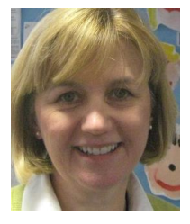
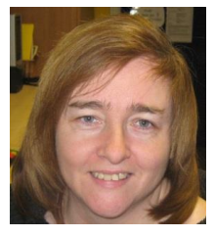
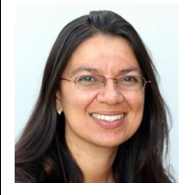
Year 1 Team
Mrs. Davies
Mrs. Wormleighton
Mrs. Worthington
Notes:
Explain staff in contact with the children throughout the week
Allow time to introduce the class governor – allow them time to introduce themselves and their role in the governing body.
Explain what happens when you have PPA and the fact that the children will have someone else on that day.

Slide 3

The Curriculum and Learning Challenges
Notes:
Explain details of the types of topics the children will cover and also that they will get an outline of the half term topics and learning at the start of each half term so they can support the children outside of school.
The Blogs – explain that these are updated each week on a rota basis allowing the parents to see what has been going on in school.
Class Page – explain that this will be the place to go to see what the children are learning, where photographs of the class will be uploaded. This will be launched in September and will provide a plethora of websites to support learning, help us to upload homework and tasks. The parents will be provided with a login in September communicated via a sticker in the children’s reading records.
Religious Education – we have an agreed syllabus that all community schools must follow. Our curriculum teaches 50% Christianity and 50% other religions based on the context of the school. Explain that the long term overview can be found on the website with more detail. Share an example of MTP. Explain that it is enquiry based and starts with the children’s prior knowledge and understanding. They then go on to learn about how the faith is shown through the daily practices of the people of the faith, the beliefs and values of the faith and then finishes with the children reflecting on what they have learned.
Explain that all classes visit a place of worship:
Rec and Y1 and Y2 – Church
Year 3 – Buddhist temple
Year 4 – Synagogue
Year 5 – Mosque
Year 6 - Church
Share also the class gallery which will have photographs uploaded as well as the curriculum gallery with examples of special events throughout the year.
Explain that there are other pieces of information also on the school website e.g. holiday lists, school development plan, policies etc
Share with the parents where the Visual Calculation Policy is and how this will help you to see how we teach maths.
Give out the Maths and English expectations booklets.
Explain to the parents that each class has a set of objectives that they need to achieve and that these are age related. Included in this are mastery objectives for those children who achieve all the age related objectives.

Slide 4
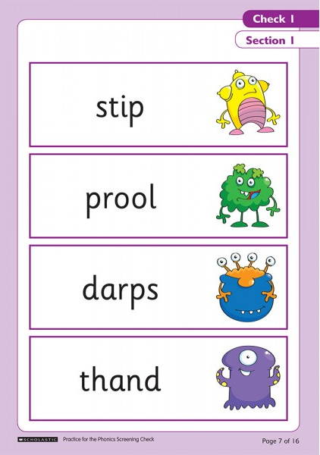
Year 1 Phonics Screening Check
Notes:
Explain what this is and how they can support. Explain how phonics is taught.
Mention that there will be a Parent Workshop for Reading and phonics early in the Autumn term to help support with this but that reading at home every night is vital to ensuring the children develop those blending skills needed.

Slide 5
How will the teacher know my child?
Transition days
Teachers will pass on information in a staff meeting
Piece of writing which will be marked by their next teacher
Tracking documents are shared for all subjects
Student Passports/Personal Education Plans
Routines shared to ensure seamless transition
Discussions around each child
Groupings for guided reading, spelling etc. will be shared

Slide 6






Our Core Values
Notes:
As well as our curriculum, we strive to help the children develop our core values which will stand them in good stead for the future.
Discuss what each of them means and how this might be displayed in school.
Explain about the hands in the celebration assembly.
Discuss how parents can support this especially the responsibility – allowing the children be responsible for their belongings.

Slide 7

Guided Reading
Your child will take part in two guided reading session every week. This will include a pre-reading session and then a comprehension session which will be when the teacher teaches your child to use the text to answer a range of questions.
The text they read in class will be at an instructional level. Your child will be given a reading target to work on.
We will make a comment in your child’s reading diary. We will indicate how your child is doing in relation to their reading target, and may indicate next steps.
Reading records are vitally important as they provide the evidence base for making teacher assessments throughout the year. These are moderated by the Senior Leadership Team.
Please don’t lose them!
Notes:
The reading book your child takes home is at an independent level and the one they read at school is instructional level, above that of their current level to enable the teacher to teach them key skills.
Reading records – explain the boxes for them to write in and the comments for the teacher. Please sign and make a comment in your child’s diary and then the book will be changed. We monitor the frequency of the book changing. Share your own personal organisation around book changing and stick to it!
Even though, your child is further up the school, they still need to be questioned and as a parent you have a vital role in this.
Any additional reading can also be recorded in the additional reading box.

Slide 8

Home Reading
It is expected that your child reads at home every evening. Please make a comment in your child’s diary and sign it. Please ensure there are at least two signatures each week with a comment.
Home readers are at an independent level. We will begin to use benchmarking next year to assess comprehension as well as reading ages. This will indicate when your child is ready to move on to the next level in their reading – please trust us!
This year we are introducing a reward scheme to celebrate those children who read at home.
Bronze Award – 20 books
Silver Award – 40 books
Gold Award – 60 books
Reading Champion Award – completion of a range of reading tasks to allow the children to experience
Notes:
The reading book your child takes home is at an independent level and the one they read at school is instructional level, above that of their current level to enable the teacher to teach them key skills.
Reading records – explain the boxes for them to write in and the comments for the teacher. Please sign and make a comment in your child’s diary and then the book will be changed. We monitor the frequency of the book changing. Share your own personal organisation around book changing and stick to it!
Even though, your child is further up the school, they still need to be questioned and as a parent you have a vital role in this.
Any additional reading can also be recorded in the additional reading box.

Slide 9
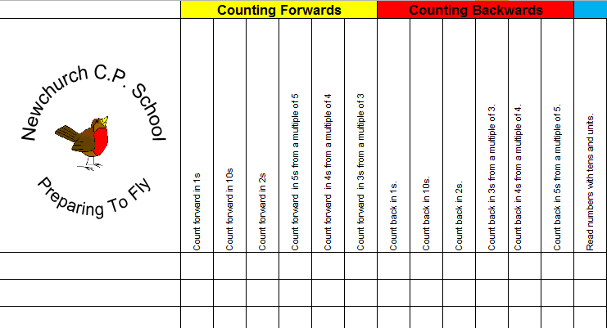
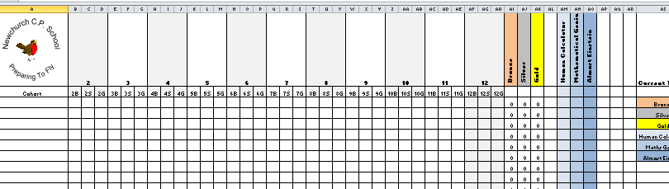
Maths Awards
The Number Booklet will challenge the following areas:
Counting Forwards
Counting Backwards
Tens and Units
Number Bonds
Doubling
Halving
The Time Table booklet will cover x2 to x12 and will extend to the use algebra, ratio, decimals and fractions.
Notes:
Basic skills in mathematics is once again a key area of focus this year and all classes will be working with the Number Booklet and Time Tables documents in class. These documents follow on from one another with the Number Booklet initially developing the children’s knowledge of counting, the number system and skills such as doubling and halving. Each child will have a booklet recording their progress in school and class teachers will be able to instruct parents on areas which can be worked on at home. Each of the kay areas will contain six targets, once all six area achieved the child will receive a certificate as a reward. When all six major areas are completed the child will move onto their Times Tables booklet.
The Times Tables booklet will cover their knowledge of the tables from x2 to x12 and will initially look at three processes (rote recall – bronze award, answering questions – silver award and using inverse processes – gold award). Once the child has received gold in all areas they will move onto advanced usage of their tables including decimals, fractions, ratio and algebra. This will form the Human Calculator, Maths Genius and Almost Einstein sections of the Times Table booklet.
The class teachers will send home details of where your child is up to in relation to the Maths Awards.

Slide 10

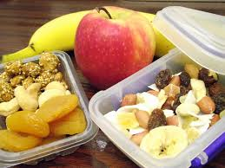
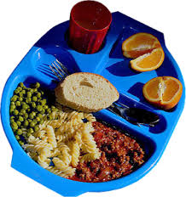
School Dinners and Snacks
Notes:
School dinners are available everyday and we have a staggered approach.
SNACKS – make sure you highlight that we have noticed the children’s snacks being less healthy. Explain that the school promotes healthy eating and there is a new snack policy on the school website.

Slide 11
Packed Lunches
At least one portion of fruit and one portion of veg/salad.
Meat, fish or another source of non-dairy protein should be included in each meal.
A starchy food, such as bread or pasta, rice, couscous, noodles, potatoes or other cereals, should be included every day.
A dairy food, such as semi-skimmed or skimmed milk, cheese, yoghurt, or fromage frais should be included every day. Please check the sugar content first, as some dairy products can have a lot of added sugar.
Include only water, low sugar or no sugar cordial, fruit juice or milk as a drink.
Snacks such as cereal bars.
Chocolate coated biscuits or wafers.
Cakes
Meat and pastry products such as sausage rolls or pies.
Confectionery such as chocolate bars
Sweets
Fizzy drinks
Notes:
To express our commitment to healthy living there will be a new packed lunch and snack policy introduced for the 2017-2018 academic year. The aim of the policy, which will be added to the policies section of the school website, is designed to ensure children have healthy and nutritious food in school, whether they bring food from home, or eat school lunches. The green section is acceptable, orange acceptable on occasions and the red section is a list of foods which aren’t permitted.

Slide 12


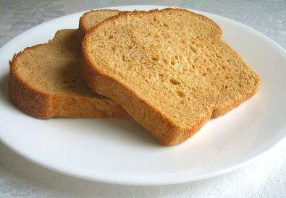
Break Time Snack
OR
Notes:
Children are permitted to bring in a piece of fruit or veg/salad for snack or alternatively they can purchase an orange or apple juice and wholemeal toast for 50p per day.

Slide 13



Behaviour
.
Bullying:
Intentional
Persistent
Imbalance of power
Notes:
Bullying is a term to include offensive, abusive or intimidating behaviour, repeated unjustified criticism, calculated humiliation, shouting, swearing and physical assault.
Newchurch has a zero tolerance to bullying and the children are very aware of this. In November, we have an Anti-bullying week where the children complete activities and are reminded of the definition of what bullying is. However, this does not mean that we only focus on it in that month. It is constantly referred to and our behaviour standards reinforced. This year, we are going to aim to build on the success of our Wise Up Award which we received last year.
Any evidence of bullying at Newchurch School will be treated very seriously and will not be tolerated.
Children are encouraged to report any concern regarding bullying of themselves or others. We use the above criteria to help children to recognise bullying and also use this to help recognise when the word BULLYING is used incorrectly. Sometimes, incidents take time to investigate as quite often there are other children who are witnesses or involved. Every incident brought to us is dealt with seriously, and is documented. We have safeguarding logs which are filled in and these are monitored by Mrs Lawrenson every week, analysed by Mrs Narraway each half term and reports given to governors. Support, intervention and sometimes curriculum changes are put in place as a result of any issues that may arise.
To support the children and to also help them to reflect on relationships, we have a very bespoke and thorough Personal, Social, Health and Emotional Curriculum which runs alongside our main curriculum. Each class has a session each week were various issues are looked at such as managing anger, dealing with loss, mental and physical health etc.
Praise points are used to acknowledge the positive behaviours displayed by our children. These can be given by anyone in the school and when the children achieve 50 = Bronze, 100 = silver, 200 = Gold, 500 = Platinum and 1000 = Diamond.

Slide 14



E-safety
Notes:
Remind parents of the necessity to keep their children safe. Explain that people seem to think that it is no longer safe to let their children out to play as some harm may come to them, but in actual fact, there has been a reduction in those kinds of incidents. Children who use the internet and access inappropriate sites are at great risk.
As part of the Computing curriculum, children from Reception to Year 6 will learn about keeping themselves safe on the internet. Year 4, 5 and 6 have workshops from the police. We acknowledge that in a highly technological world, children will want to use certain apps such as Instagram, but monitor your child’s use of this. Children can follow people and have access to inappropriate materials just by following them. You child can follow others as it is cool to have as many followers as possible. Talk to your children about never giving their address out to strangers. Believe us, this happens.
Children need to be 14years old to have a Facebook account.

Slide 15


Timetable
Bring PE kit in on Monday and take home on Friday.
French is on a Monday.
Notes:
Most things are flexible but these will remain static!
PE: Go through the PE kit expectations – trainers, white t-shirt and black shorts, black hoodie and black leggings or tracksuit bottoms. You will be notified by text if your child does not have the correct uniform. We would recommend that they bring them in on a Monday and take home on a Friday.
Add any additional information to your slide:
Year 3 Keyboard
Year 4 – Gospel
Year 5 –Guitars
Year 6 - Brass

Slide 16
Homework
Year Group | Homework set | Time to complete task | Additional expectations
1 and 2 | One piece of mathematics and one piece of English per week. Differentiated spellings | 30 minutes (15 minutes per activity) | Read twice per week Ongoing rote practice of basic skills in mathematics eg. Number bonds and times tables
3 and 4 | One piece of mathematics and one piece of English per week Differentiated spellings | 45-50 minutes (Approx. 25 minutes per activity) | Read twice per week Ongoing rote practice of basic skills in mathematics eg. Number bonds and times tables
5 and 6 | One piece of mathematics and one piece of English per week Differentiated spellings | 1 hour per week (30 minutes per activity) | Read twice per week Ongoing rote practice of basic skills in mathematics e.g. Number bonds and times tables
Set on a Monday and returned the following Monday
Spellings- Pre-test given and then one after learning to show progress
Notes:
Monday to Monday is non-negotiable. Homework can be handed in at any point in the week as long as it is in by the following Monday. There are two books which will alternate.
It is important that homework is completed. If the children do not understand the homework, then they need to speak to their teacher. As the children get further up the school, they need to be more independent and responsible for their homework. The homework should consolidate the children’s learning from the previous week and so they should be able to do it on their own. Please ensure that presentation is of the same quality they would expect to have in school. An expectations sheet will be in the children’s homework book. Share expectations sheet with the parents.
Spellings will be linked to assessment of the children’s spelling needs as part of our whole school focus. Explain that we give a pre-test and measure progress. This will be reported in your child’s homework book. There are also spellings that are linked to the age related expectations. These need to be learnt. Provide parents with the list of spellings for the year group.

Slide 17
Attendance, School Dinners and Snacks
Notes:
Over the past year we have reduced the percentage of authorised and unauthorised absences. We are very proud of this. If your child is ill, please ring school on the morning of their first day of absence. If you don’t, please expect a call. Holidays in school time are not permitted and will not be authorised. Only under exceptional circumstances will an absence from school be authorised. All requests should be submitted in writing to the headteacher. There is a direct correlation between school attendance and school performance. Attendance is carefully scrutinised and should attendance fall below a given percentage then coordinated and graduated action is taken. Initially, a letter, followed by a meeting.
School dinners are available everyday and we have a staggered approach. If you think that you are eligible for Free School dinners, please ask the office for a form. If you look on the charging and remissions policy on the website, you will see how you will benefit from the application. In addition, the school receives additional funding which goes towards additional support for your child e.g. additional Teaching assistants, reading schemes, etc. The impact of this is measured to make sure there is value for money. If you think you are eligible, it is definitely worth applying.
SNACKS – make sure you highlight that we have noticed the children’s snacks being less healthy. Explain that the school promotes healthy eating and can all snacks be healthy – no chocolate bars or crisps. Ideally, a piece of fruit or cereal bar.
Explain the children need a water bottle filled with water – not juice.

Slide 18
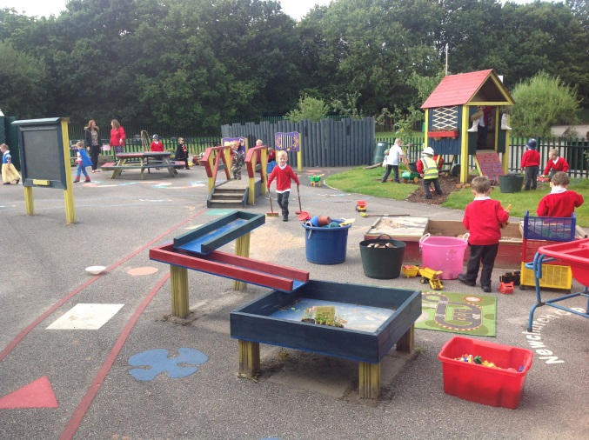
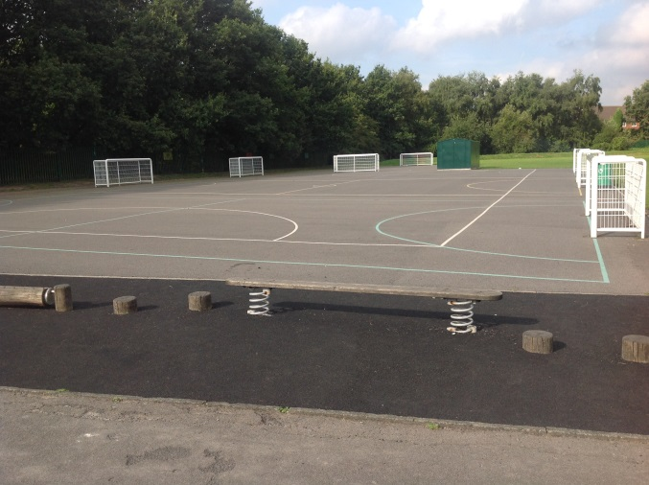
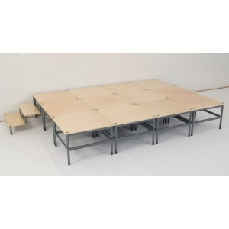

PTA
Notes:
Key areas: As a parent, you are automatically a member of the PTA. The PTA has raised money for the Early Years outdoor area, the football pitches, all our ipads and more recently, the stage.
Without the PTAs contribution to the school, these things could not be afforded and we are very grateful to them. The PTA meets once a month and is not clicky at all.
Please give your time according to your capability e.g. if you can set up but can’t attend then please do. If you can attend but not set up then that is fine. If you can only come to help clear, then great! Every little bit helps.
Each class is responsible for a particular event and it would be great it everybody pitched in no matter how small a contribution – every little helps.

Slide 19

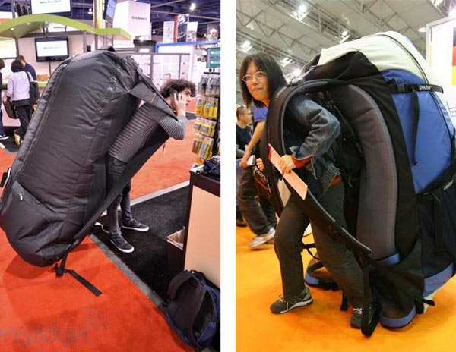
The First Day Back…
Notes:
Explain where the children are to be lined up and routines around picking up – we aim that the children are much ore independent.
Explain what the children need to have with them – size of the children’s bags!

Slide 20

Questions
Class teacher
Mr.Duckett
Mrs. Narraway
Notes:
Explain that if ever there are any issues you wish to discuss then the best person to see is yourself the class teacher, as you are with the children the vast majority of the time, including playtimes and are more than likely to be able to help quickly. It is better to ask to make an appointment at the start of the day for after school, as staff are not always able to have their classes covered at the start of the day without prior notice.
If you are still not satisfied, then speak with Mr. Duckett.
If still not satisfied, then make an appointment to speak with Mrs. Narraway.
If the issue is a safeguarding issue, then go directly to Mrs Narraway as she is the Designated Senior Person for safeguarding. In her absence, Mrs Wormleighton.

