Slide 1
Contingency Plan

Slide 2
Allocation of Devices

Slide 3
Procedures of Lockdown
Parents will be informed via letter and alerted by text to collect their children or notified that they are not to come into school.
Children will be collected and take their pack of resources with them. Alternatively, resource packs will be delivered to the family home.
Emergency ‘Day 1 of lockdown resources’ will be provided for the children via Google Classroom
Day 2 – online learning will commence for the duration of the lockdown.
This needs to be prepared in advance and can be some of the materials from the school closure. Get this ready and place in the shared drive under EMERGENCY LOCKDOWN.

Slide 4
Tiers of Remote Learning
Tier 1
Tier 2
Tier 4
Tier 3
A child is off school for a few days and is well enough to complete some work.
A child is required to isolate for a longer duration as detailed in the government guidance and is well enough to complete some work
A child’s class is required to isolate for a longer duration as detailed in the government guidance and is well enough to complete some work.
The whole school is required to work remotely.

Slide 5
Tier One
A child is off school for a few days and is well enough to complete some work.
Children will be expected to:
Complete uploaded Maths and English activities accessible on Google Classroom
Complete any topic work
KS2 children will be expected to access Reading Plus every day
KS1 read their home readers or share a book with an adult
All children with a TTRockstars account should access it every day

Slide 6
Tier Two
A child is required to isolate for a longer duration as detailed in the government guidance and is well enough to complete some work
Children will be expected to:
Complete uploaded Maths and English activities accessible on Google Classroom
Complete any topic work
KS1 read their home readers or share a book with an adult – access https://home.oxfordowl.co.uk/reading/ for online ebooks
KS2 children will be expected to access Reading Plus every day
All children with a TTRockstars account should access it every day

Slide 7
Tier Three
A child’s class is required to isolate for a longer duration as detailed in the government guidance and is well enough to complete some work.
Children will be expected to:
Engage in the daily register and live streaming of spelling lessons
Access the Loom lessons or recorded videos provided by the class teacher to support them in their learning
Complete uploaded Maths, English and Topic lessons via Google Classroom
Upload their learning for marking and feedback
Attend weekly welfare meetings using Google Meet
KS1 read their home readers or share a book with an adult – access https://home.oxfordowl.co.uk/reading/ for online ebooks
KS2 children will be expected to access Reading Plus every day
All children with a TTRockstars account should access it every day
Engage in whole class novel read by the class teacher (live streaming)

Slide 8
Tier Four
The whole school is required to work remotely.
Children will be expected to:
Access learning as detailed in Tier 3
Access the celebration assembly and whole school assembly via a Loom link
Engage in additional enrichment activities which will keep the Newchurch Family united

Slide 9
Whole School Lockdown
Reception and Key Stage One | Keys Stage Two
Daily Phonics session (live stream following registration) Daily Maths session Daily English session Daily reading activity Topic session Guided reading session (live) Handwriting session Some child initiated activity challenges linked to the children’s learning Daily story to end the day (live) | Daily spelling session (live stream following registration) Daily Maths session Daily English session Daily topic session Independent reading using Reading Plus (30 minutes) Guided Reading sessions (live) Independent times tables practice using TTRockstars (20 minutes) Daily story to end the day (live)

Slide 10
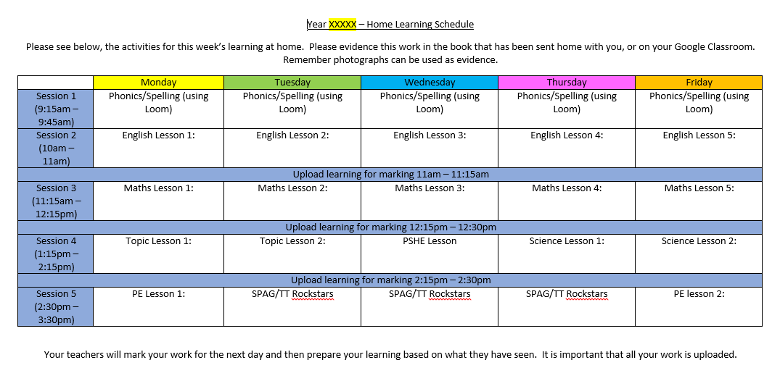
Timetables

Slide 11
The teachers will…
Consider the work provided for the children to facilitate those who may not have an available adult to support them
Maintain a register of pupils who have engaged with the remote learning and contact parents in the event no learning is submitted to provide support
Be online through Google Classroom to support children throughout the school day, either by using Google Meet, video or written (typed) feedback.
Provide feedback on work within the agreed time scale and use this to plan the next lesson in response to how the children have done to maintain the sequence of lessons. Marking and feedback will be in line with the school Assessment and feedback Policy addendum
Begin the day with a virtual register to provide details of what the learning for the day is and the expectations.
End the day with the reading of a class novel or story book
Provide videos and recorded lessons where appropriate
Ensure that any safeguarding or wellbeing concerns, as a result of absenteeism for remote learning or from observations of the children, are passed to the Designated Safeguarding Lead
Monitor and support the learning of children with Special Educational Needs

Slide 12
The teaching assistants will…
To support the teacher in the delivery of the education of the children remotely
Take specific responsibility for the delivery of guided reading with small groups of children through live streaming
Make welfare calls throughout the week
Supporting the assessment and feedback of children’s work
Responding to any support needs of the children
The office staff will…
Provide technical support for Google Classroom
Be the point of contact regarding absence from remote learning
The Special Needs Coordinator will…
Ensure the provision of support for children with Educational Health Care Plans (EHCPs)
Conduct welfare calls to all EHCP children
Ensure that, where possible, objectives from the EHCP are being delivered

Slide 13
The Designated Safeguarding Leads will…
Be on call at any point in the day to support staff and parents with safeguarding concerns
Conduct wellbeing calls to any families who require support
Check the attendance of pupils each day (start and end of the say) on the video conferencing
The Senior Leadership Team will…
Monitor the provision of teaching and learning across the school for its effectiveness and consistency
Review provision to ensure all children are able to access their learning
Ensure the wellbeing of the pupils, staff and parents of the Newchurch Family
Our Newchurch Robins will…
Make us proud by being resilient and dedicated to their learning
Take each day one day at a time
Be ready for learning each day and do the best they can!

Slide 14
Parental expectations
Working remotely is not without its challenges, particularly if you are required as a parent to work from home or have younger children to care for too. However, we have considered this when putting together our plan and hope that, with the support of the school, parents will:
Ensure their child has an appropriate device from which they can access their learning remotely. Our remote learning survey has helped us to support families with limited access to devices
Provide support for their child in accessing the learning uploaded onto Google Classroom
Ensure that the day’s programme of learning is completed and inform the teacher of any difficulties in completing the tasks set
Engage in the weekly welfare Google Meet with the class teacher
Contact the school as soon as possible to inform us if there are any difficulties in accessing the learning programme
Submit work via the Google Classroom in a timely manner to allow teachers to plan for the next day’s learning
Respect the work-life balance of the class teacher by communicating only within the school hours

