Slide 1
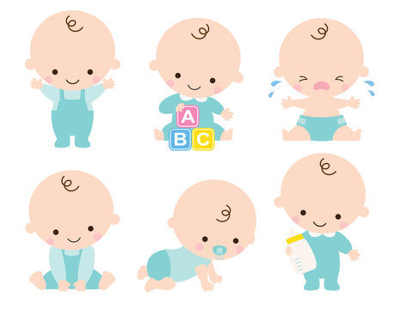
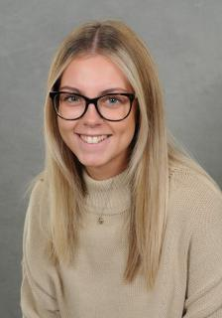
It is after the Easter holidays and I will be getting a new teacher because Mrs Brinksman-Wood is having a baby.

Slide 2
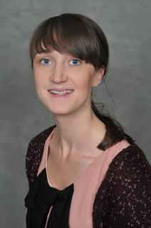
I already know Mrs Toone because she has taught me before.

Slide 3
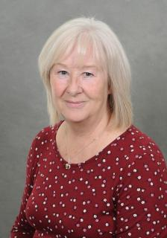
Mrs Storey will be with me in class and she will help my
new teacher learn all about me.

Slide 4
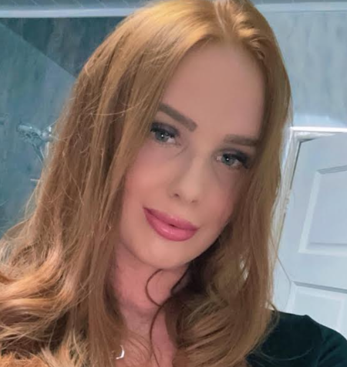
I will meet my new teacher on Monday.
She is called Miss Gaskell.

Slide 5
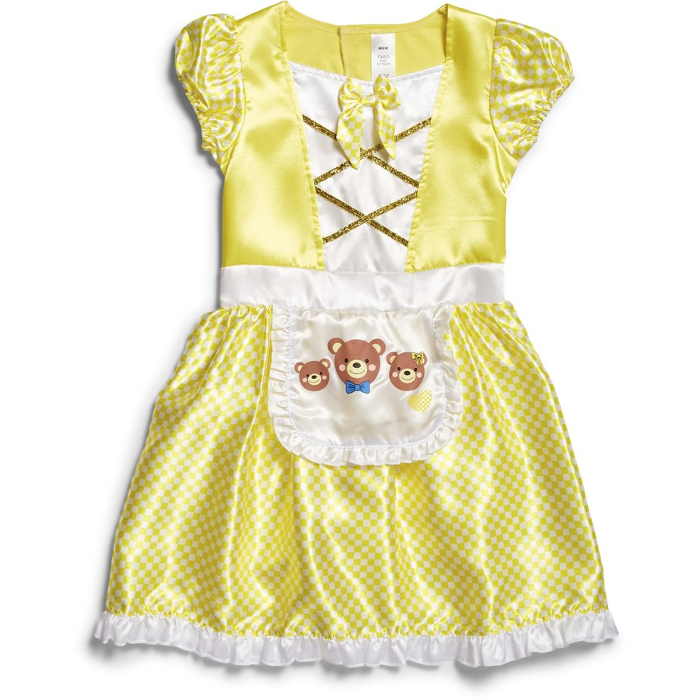
It is okay to feel nervous or worried about having a new teacher but I have met her before. She may look different on Monday because she was dressed as Goldilocks for World Book Day.

Slide 6
If I feel sad I can talk about it or do something I like to help me feel better.
I will feel better once I get to know my new teachers and they get to know me.

Slide 7
The week we come back to school
When I come to school on Monday and Tuesday, Mrs Brinksman-Wood and Mrs Storey will be teaching me.
Mrs Toone and Mrs Gaskell will be working together to plan lovely learning for me. They will meet with Mrs Narraway so she can share my student passport with my new teacher.
Miss Gaskell and Mrs Storey will teaching me on Wednesday, Thursday and Friday.

Slide 8
On Friday, my parents will meet with Miss Gaskell, Mrs Narraway and Mrs Brinksman-Wood to talk about anything that is worrying me.

Slide 9
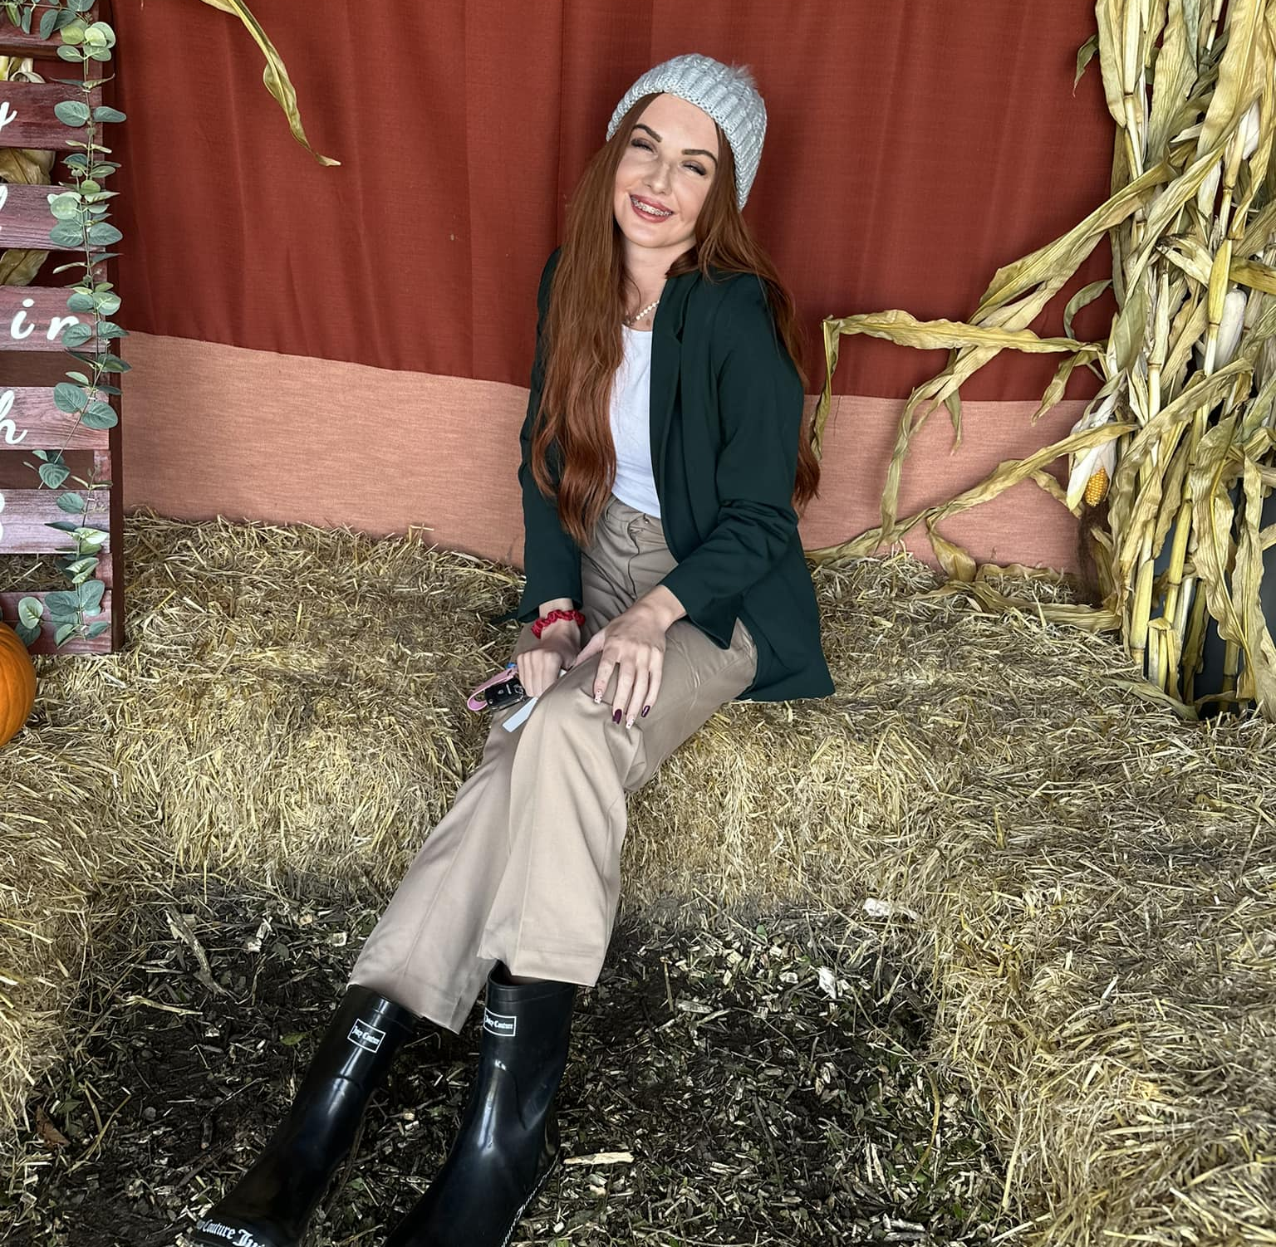
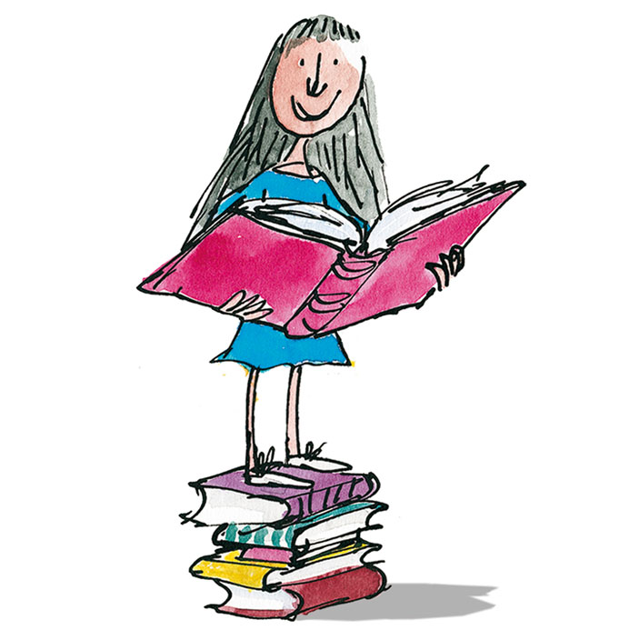
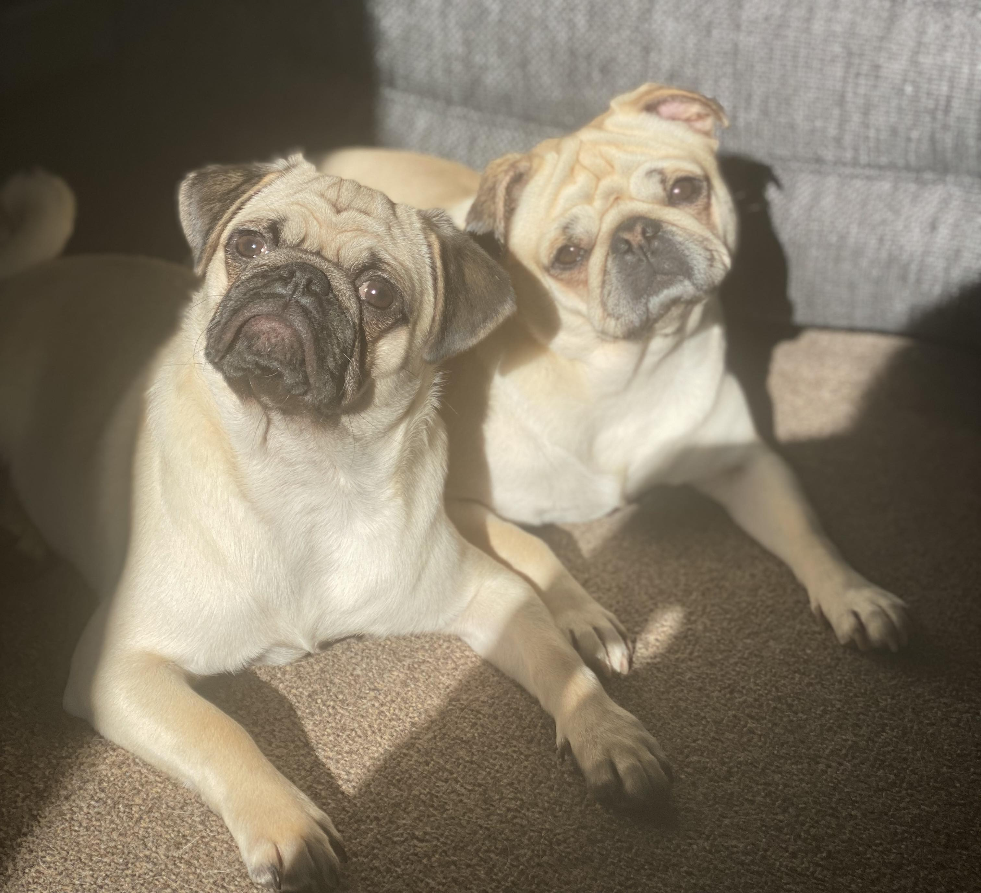
Meet Your New Teacher
Hello! My name is Miss Gaskell and I am very excited to meet you all!
This is my 1st Year Teaching since Graduating from University in July 2023.
I believe that Year 2 is a wonderful class to teach. I am thrilled to be a part of your educational journey.
My favourite subjects are English, Science and PSHE. Although, I do love to teach every subject!
Miss Gaskell
My favourite author is Roald Dahl- I spent lots of time engaging in his books as a child and I continue to admire his creativity.
I have 2 dogs called “Nova” and “Luna”.

