Slide 1


Year 2
Burwardsley July 2026

Slide 2
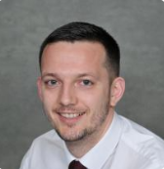
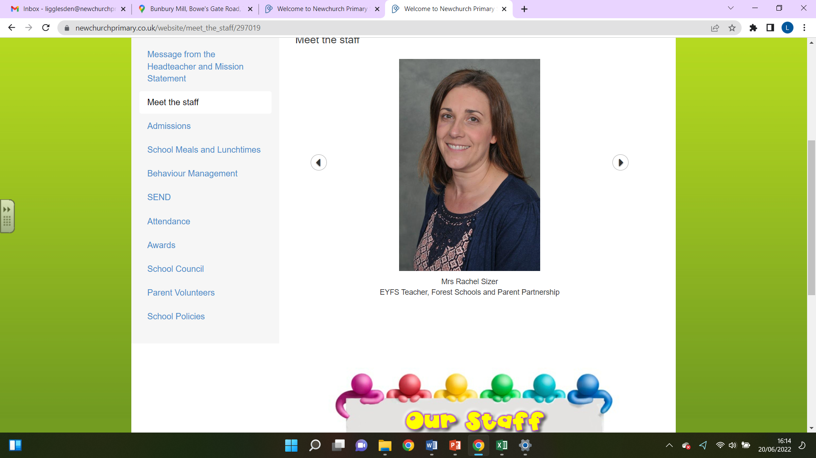
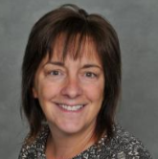
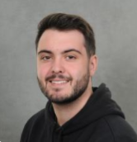
Who?
Newchurch Staff
Mr Singleton
Mrs Sizer
Mrs Price
Mr Boon

Slide 3
When and Where?
Burwardsley
Tuesday 30th June – Wednesday 1st July
The children will leave school at 11am and the coach will take the children straight to Burwardsley Centre where the children will get settled in.

Slide 4
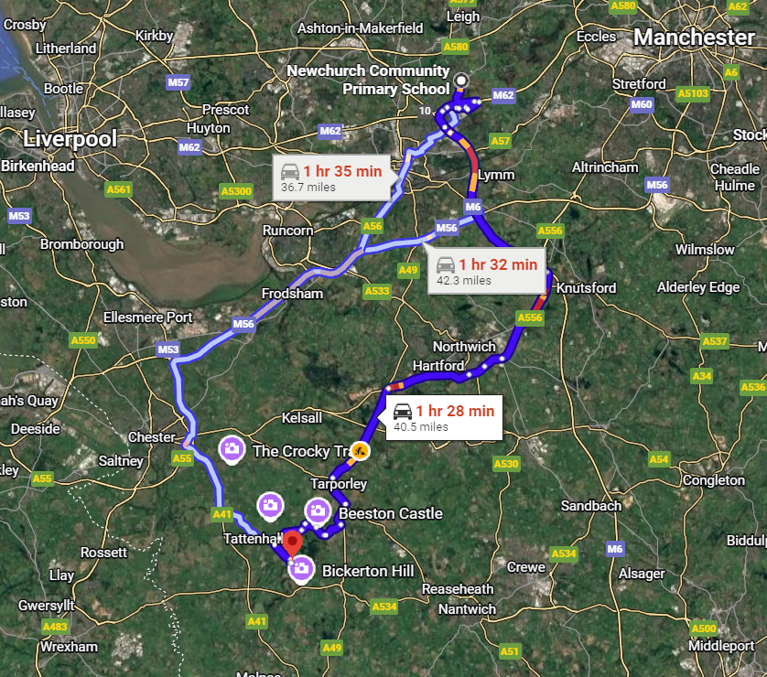

Slide 5
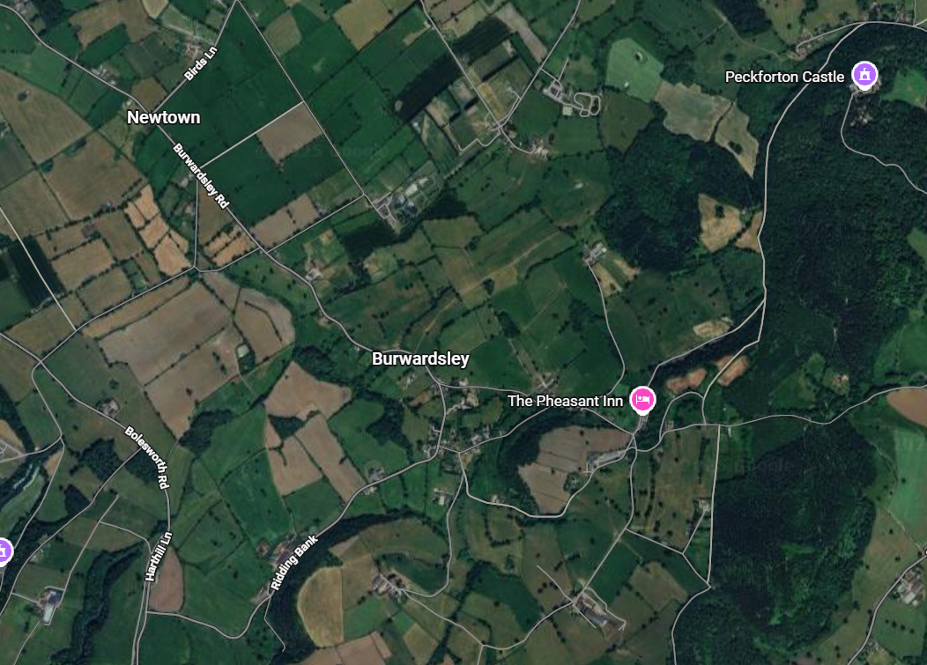

Slide 6
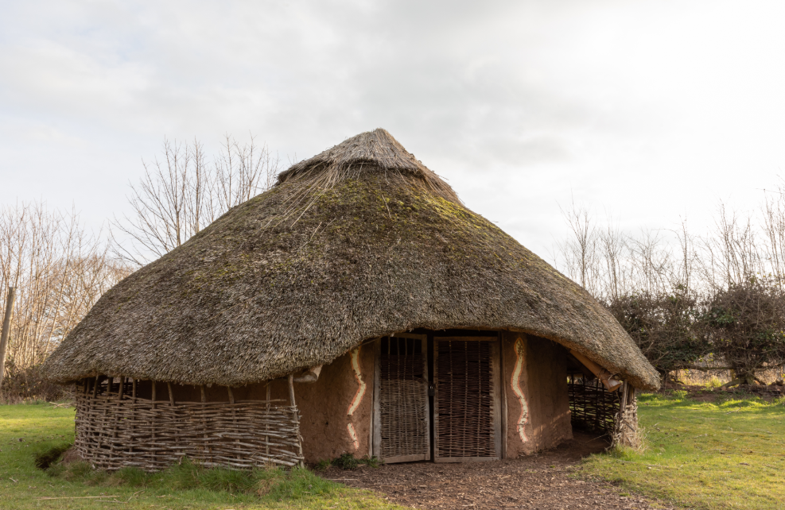
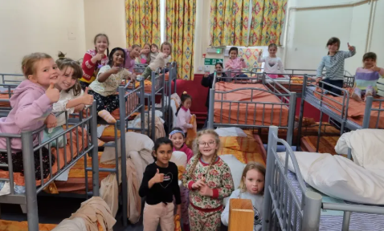
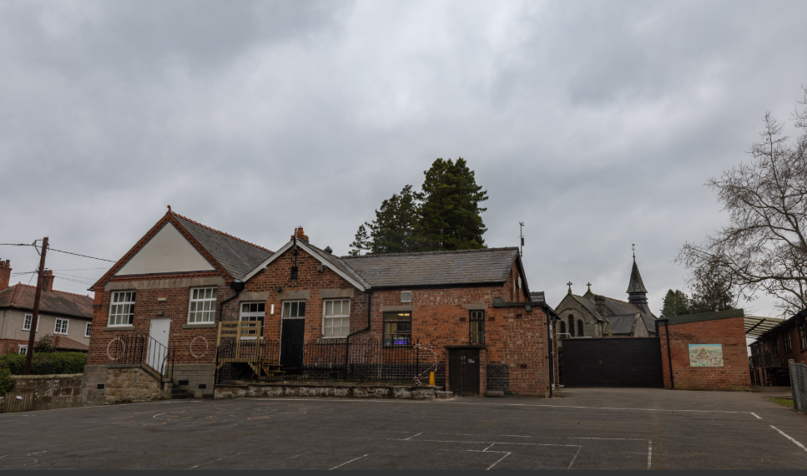
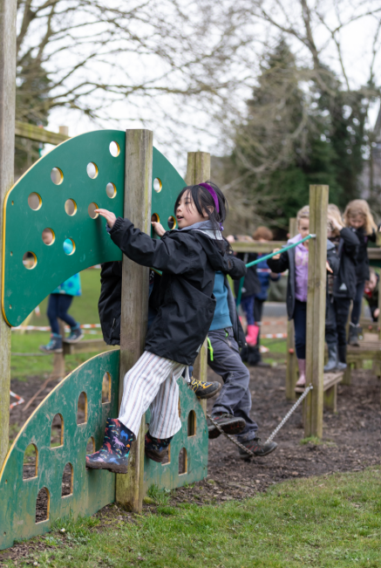
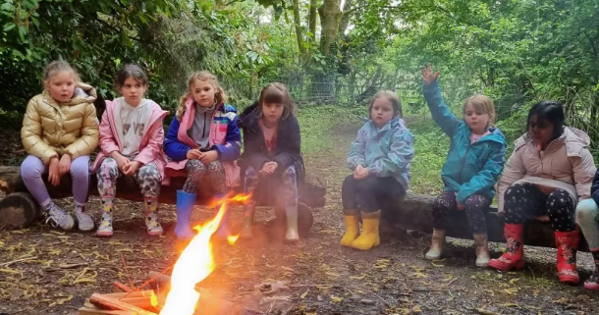

Slide 7
Itinerary
Tuesday
Leave school at 11
Arrive at Burwarsley for 12:30
Eat packed lunch
Take belongings to dormitories
Habitat walk and Den Building
Evening meal
Camp fire
Evening activity (quiz, bingo, games)
Bedtime
Wednesday
Breakfast at 8:00
Pack belongings
Morning activities (orienteering and roundhouse exploration)
Lunch
Leave at 13:30
Arrive back at school at 15:00

Slide 8
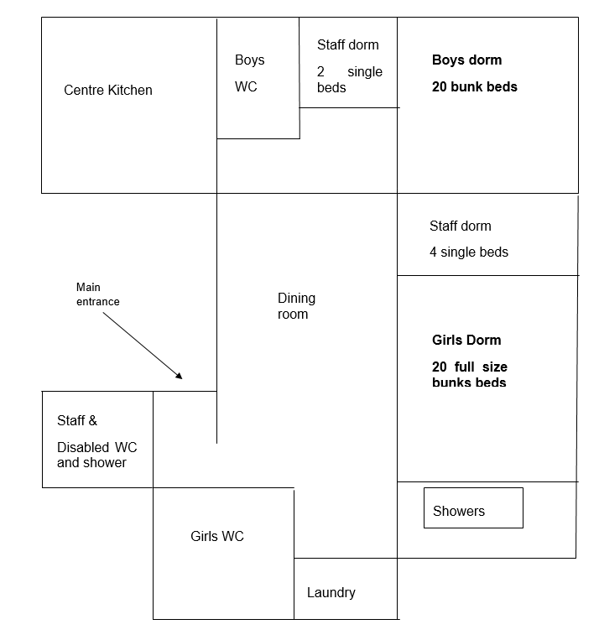
Accommodation?
The children will stay in two big rooms – one for boys and one for girls. Staff will be nearby should children need them.

Slide 9
Meal times
The children will be provided with meals whilst we are there.
Tea on Tuesday
Snack before bed on Tuesday
Breakfast on Wednesday
Lunch on Wednesday
If you have informed us that your child has any dietary requirements, this has been passed on to Burwardsley and any dietary needs will be catered for during our stay.

Slide 10
What shall we pack?
When packing your case, you may want to consider the following:
Comfortable clothing for each day joggers, leggings, t-shirts, hoodies, etc.
Comfortable trainers, wellies in case of wet weather
Waterproof coat
Hoodie or fleece in case of cold weather
Underwear, including spares
Sleepwear
Toiletries including a toothbrush, toothpaste, brush and hair ties and a small towel
Indoor shoes/slippers
Children may also bring one comfort item with them, for example a pillow or teddy bear.

Slide 11

Medication
If your child requires medication, inhalers etc during their stay, staff will ensure that this is administered to your child at the correct times.
In order to support staff in this, all medicines MUST to be handed into the office in the day before the trip. Accompanying the medicine you hand in will be a form to complete on which you will state the name of the medicine, dosages and times to be administered.

Slide 12
Conduct and expectations
As is always stated to the children during any activities, both on and off school site, we are representing Newchurch and our core values must remain at the heart of what we do. There will be times when we might mix with other schools and members of the public. The children will be supervised at all times, however, we will expect appropriate behaviour during the trip. The children are going with staff that they know so if there are any issues they know they can come and inform us. Maintaining acceptable levels of behaviour (related to the physical and emotional safety for everyone) is essential. In extreme circumstances, individuals whose behaviour places themselves or others in danger or effects the safe learning environment for others may be excluded from participation.

Slide 13

Contact
Keep an eye on Twitter and Facebook for updates on what we are up to and the activities children are taking part in.

Slide 14


