Slide 1
Tutortastic Sample A
KS1 Arithmetic Questions
NEW SATS 2016

Slide 2
1 2 3 4 5 6 7 8 9 10 11 12 13 14 15 16 17 18 19 20
Can we see if we are correct by using the number line?

Slide 3
1 2 3 4 5 6 7 8 9 10 11 12 13 14 15 16 17 18 19 20
Is this close to a number bond to 10?

Slide 4
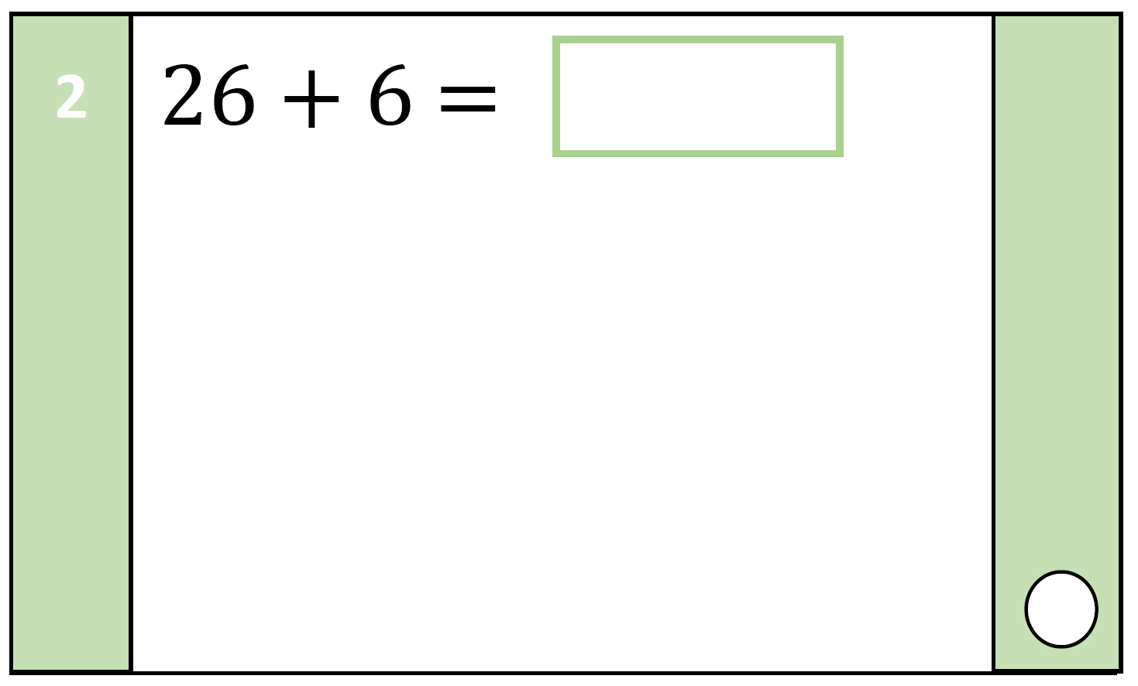
1 2 3 4 5 6 7 8 9 10 11 12 13 14 15 16 17 18 19 20
Uh oh! 6 + 6 = 12! What do we do?

Slide 5
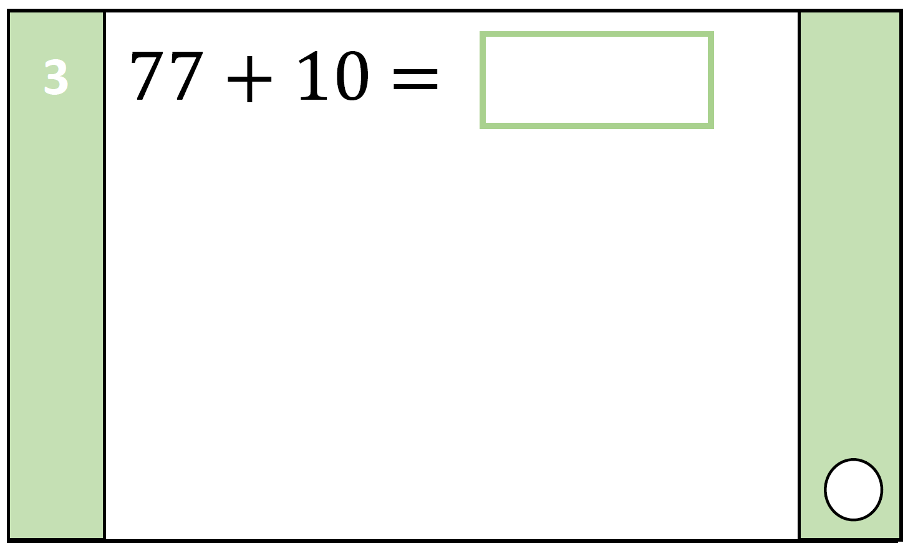
1 2 3 4 5 6 7 8 9 10 11 12 13 14 15 16 17 18 19 20
Only one number will change! Which one?

Slide 6
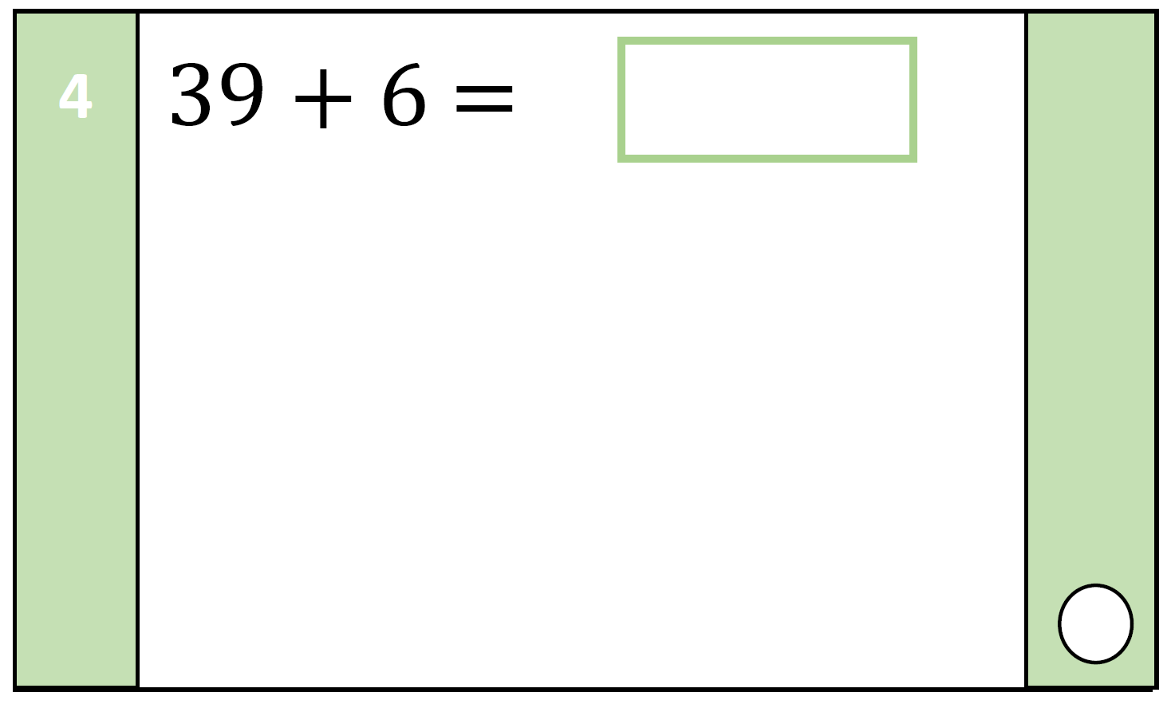
1 2 3 4 5 6 7 8 9 10 11 12 13 14 15 16 17 18 19 20
How did you add this one up?

Slide 7
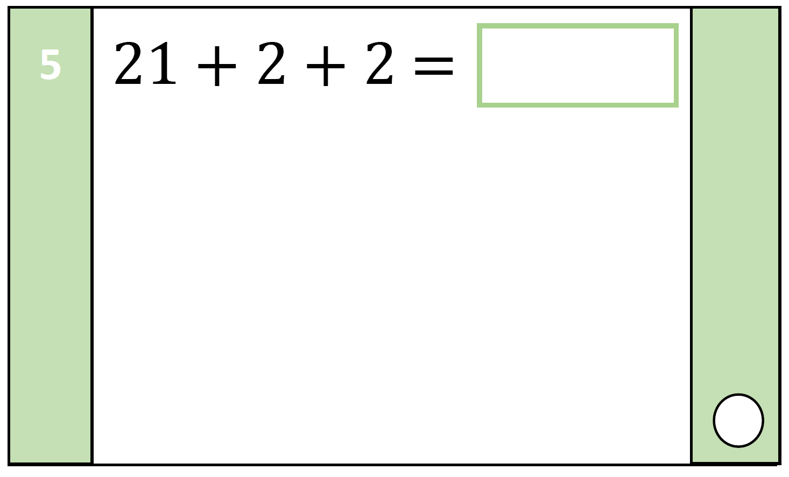
1 2 3 4 5 6 7 8 9 10 11 12 13 14 15 16 17 18 19 20
Yikes! 3 numbers to add! How could you make this one easier?

Slide 8
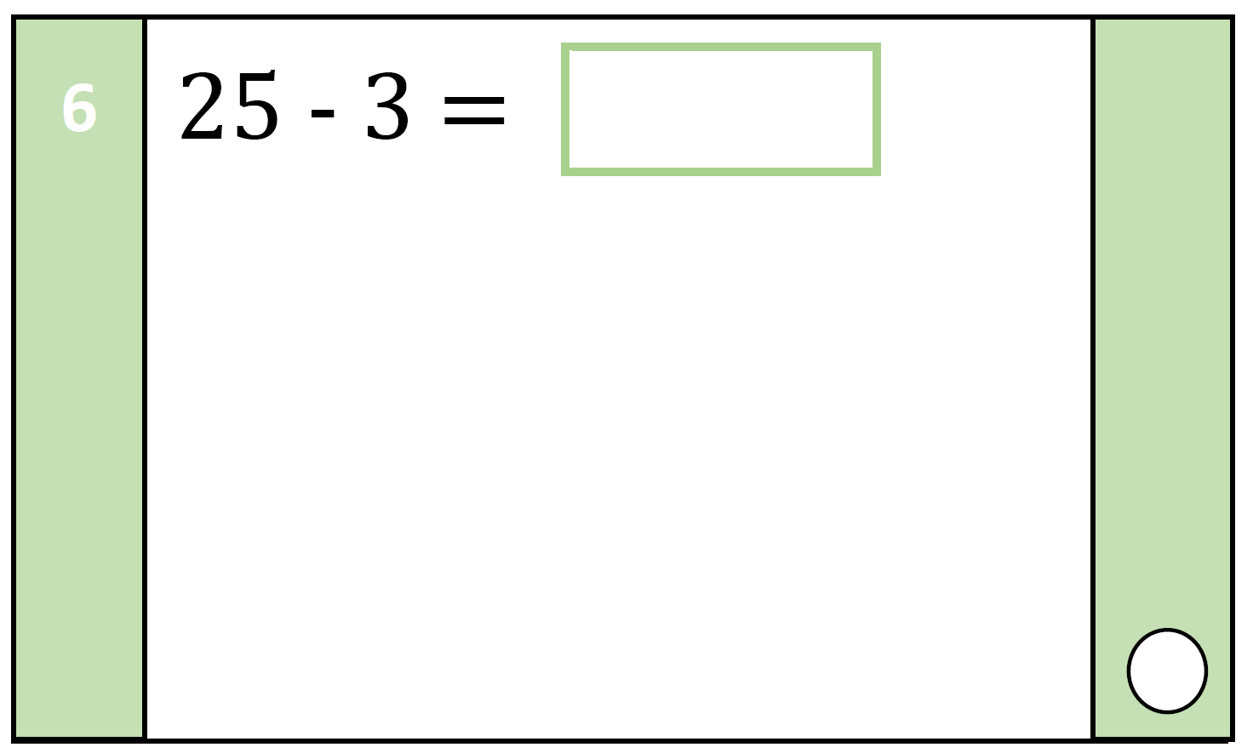
1 2 3 4 5 6 7 8 9 10 11 12 13 14 15 16 17 18 19 20
Will the answer be more or less that 25? How do you know?

Slide 9
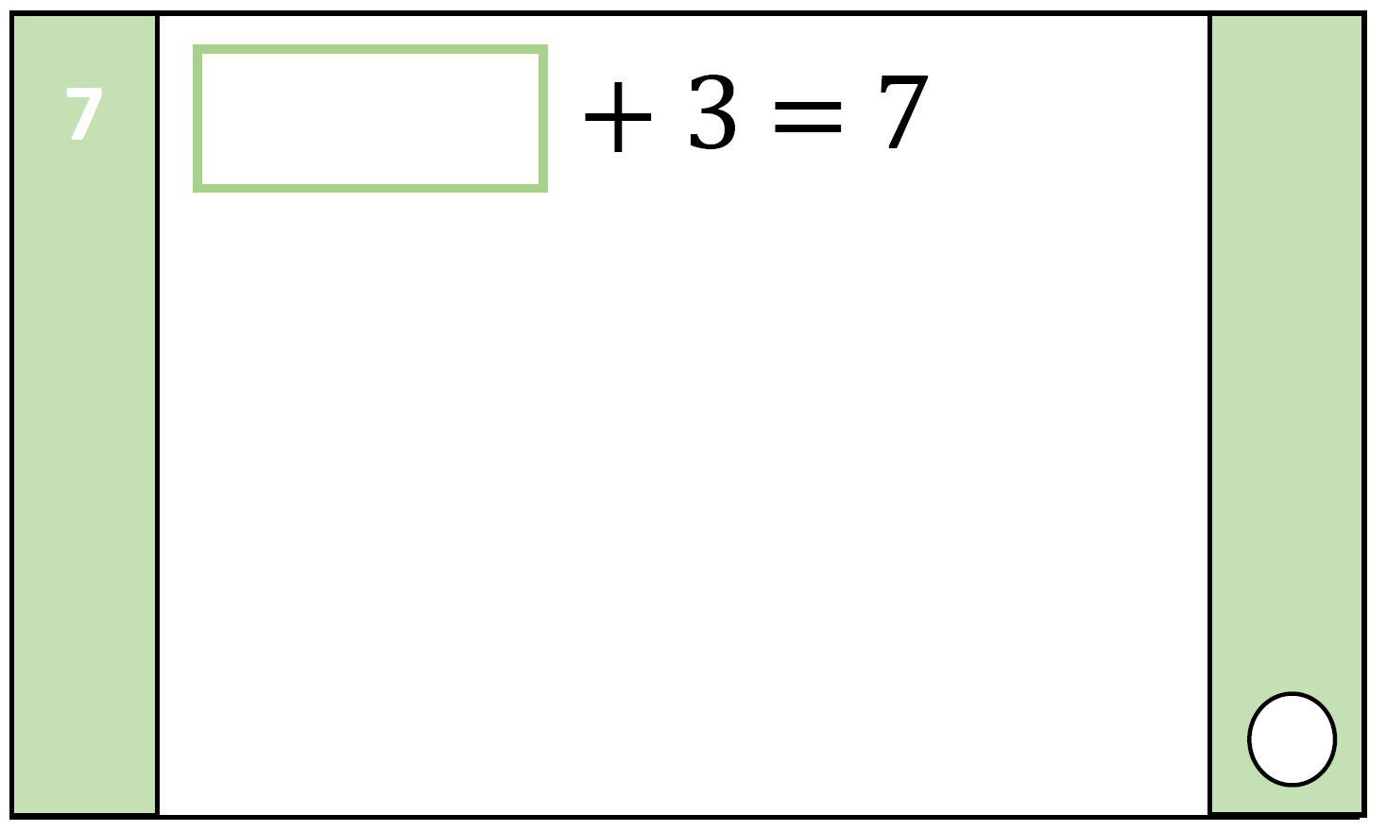
1 2 3 4 5 6 7 8 9 10 11 12 13 14 15 16 17 18 19 20
We will have to use our inverse here!

Slide 10
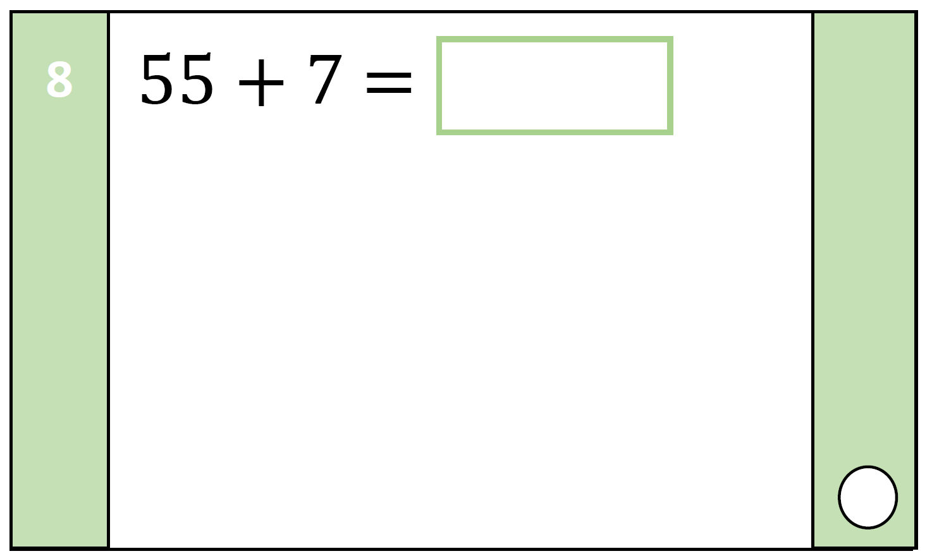
1 2 3 4 5 6 7 8 9 10 11 12 13 14 15 16 17 18 19 20
Did you carry a ten on this one?

Slide 11
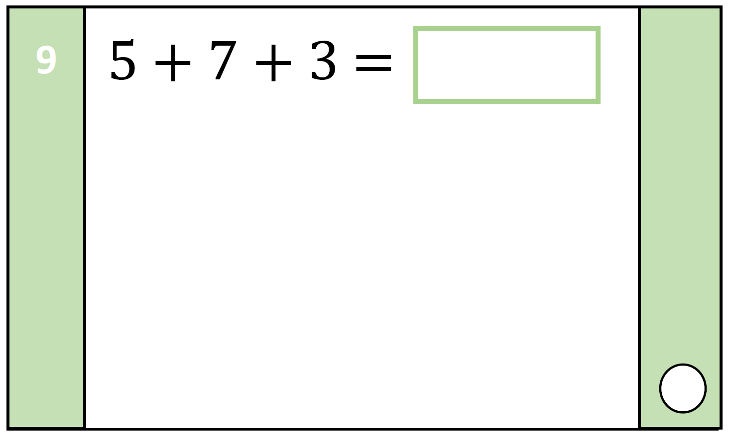
1 2 3 4 5 6 7 8 9 10 11 12 13 14 15 16 17 18 19 20
I can see a number bond to 10? Can you?

Slide 12
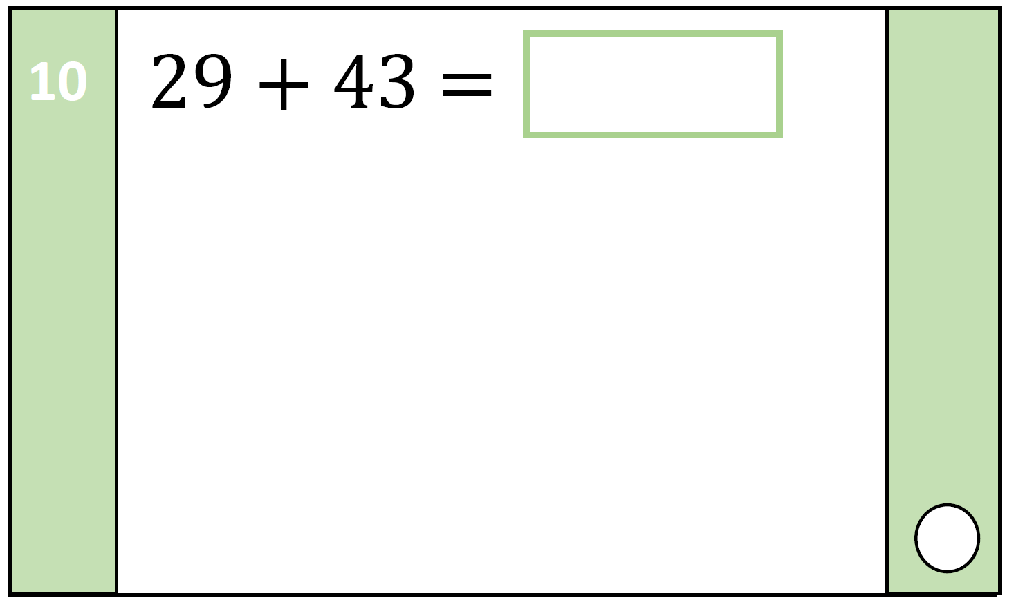
1 2 3 4 5 6 7 8 9 10 11 12 13 14 15 16 17 18 19 20
Which number comes after 29? How can that help you?

Slide 13
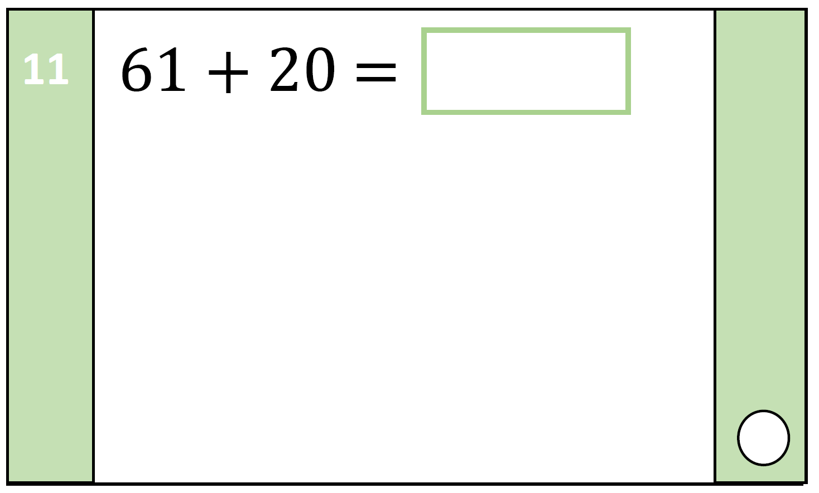
1 2 3 4 5 6 7 8 9 10 11 12 13 14 15 16 17 18 19 20
Can you count in 10’s?

Slide 14
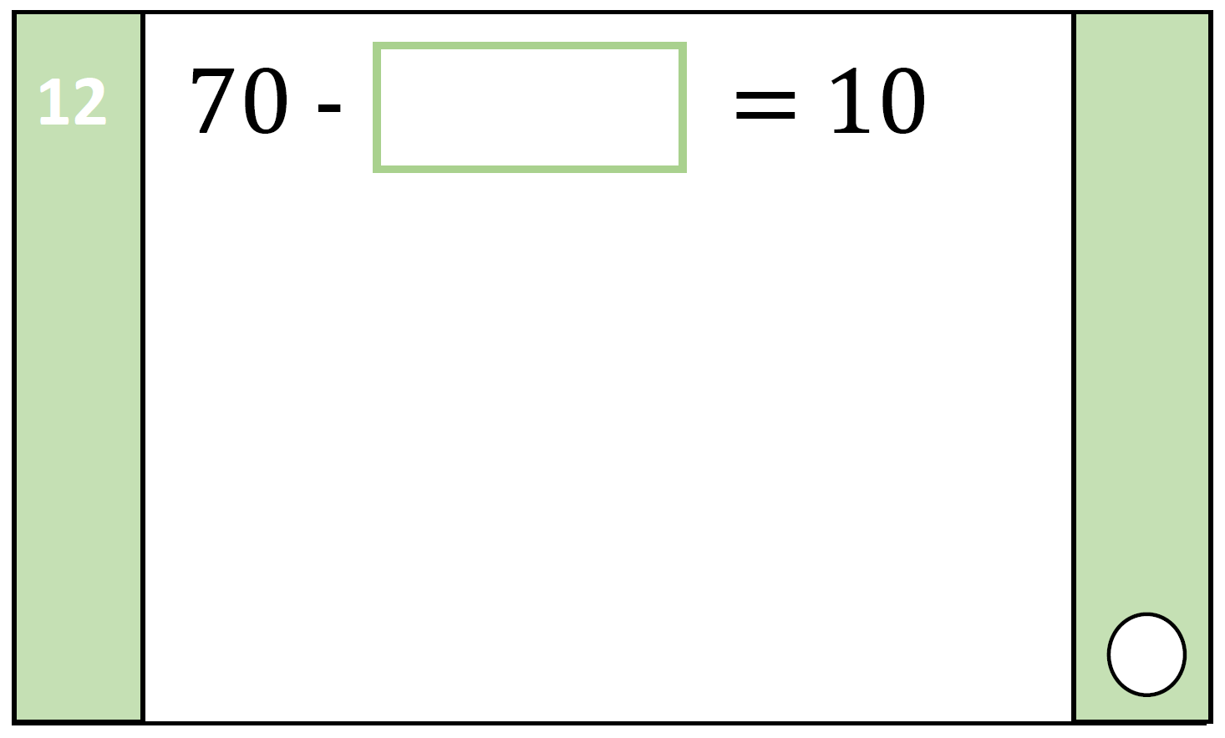
1 2 3 4 5 6 7 8 9 10 11 12 13 14 15 16 17 18 19 20
Inverse will help you!

Slide 15
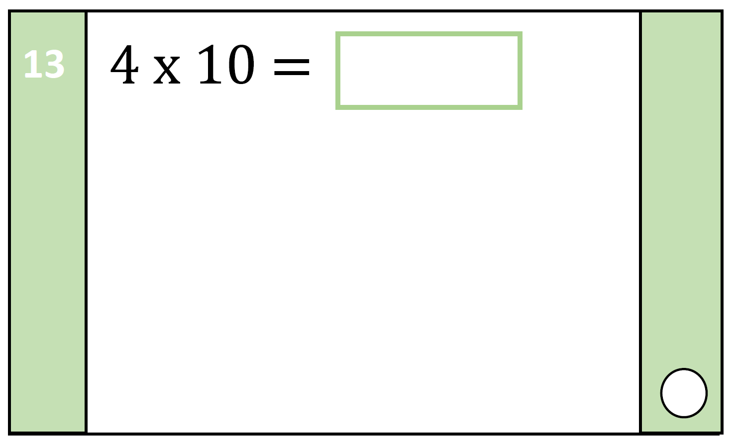
1 2 3 4 5 6 7 8 9 10 11 12 13 14 15 16 17 18 19 20
Can you count in 4’s or 10’s?

Slide 16
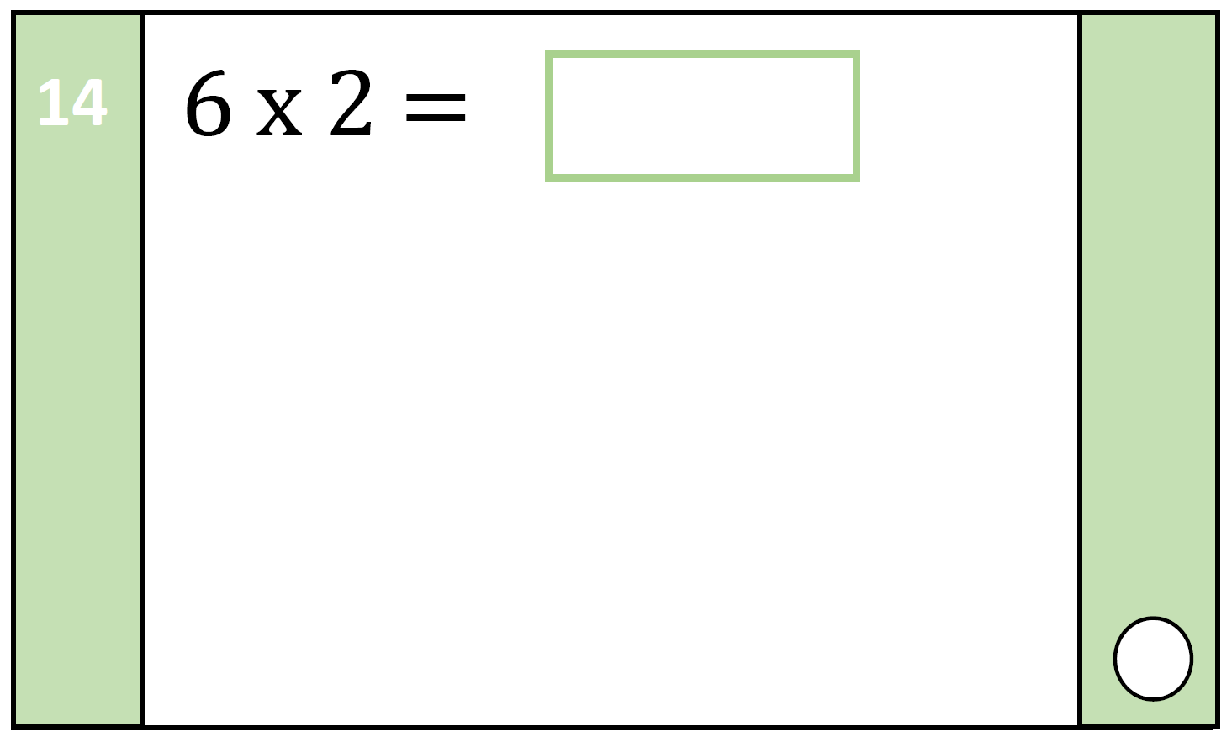
1 2 3 4 5 6 7 8 9 10 11 12 13 14 15 16 17 18 19 20
Multiplying by 2 is the same as doubling!

Slide 17
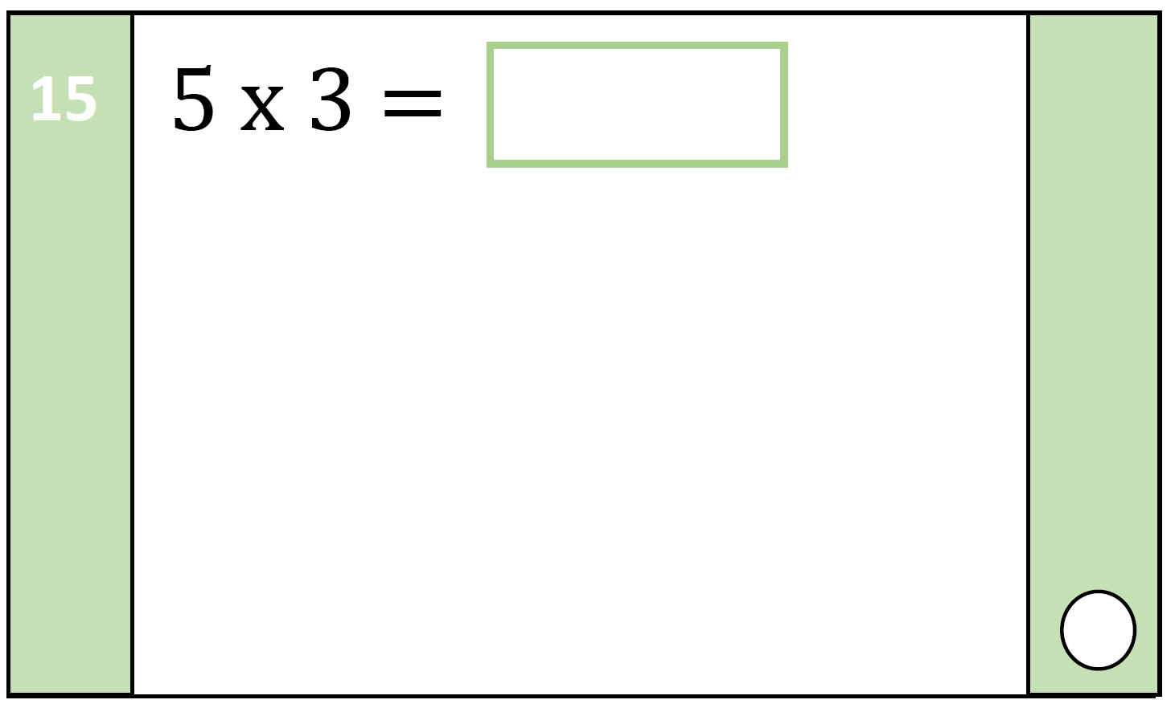
1 2 3 4 5 6 7 8 9 10 11 12 13 14 15 16 17 18 19 20
Can you count in 3’s or 5’s?

Slide 18
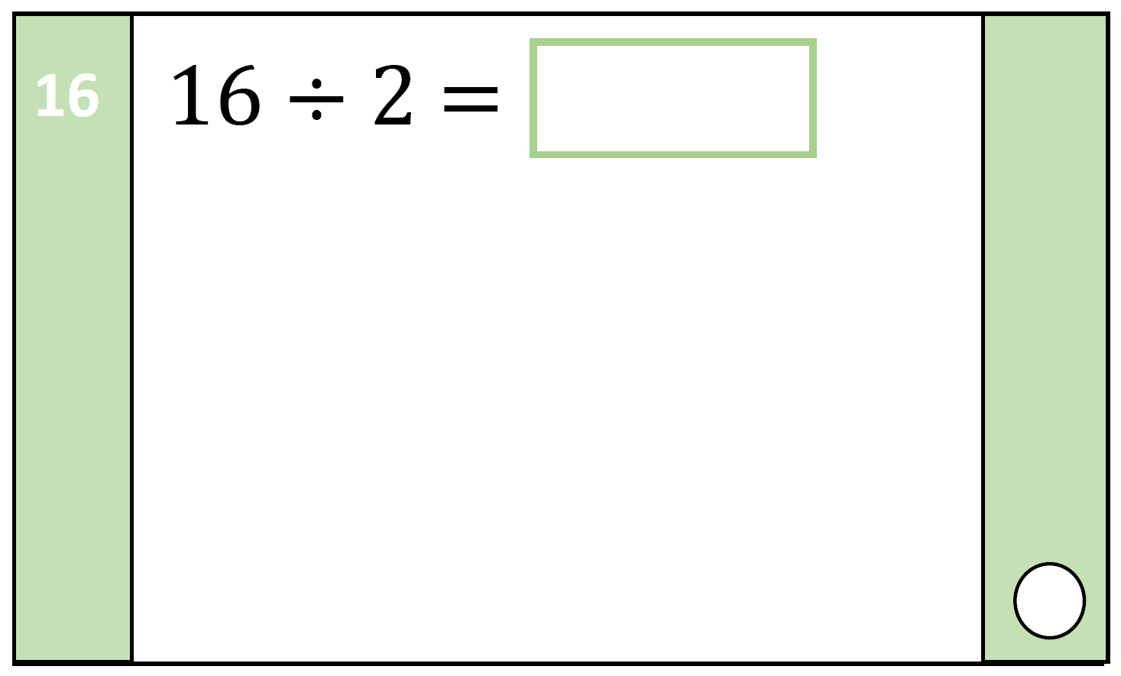
1 2 3 4 5 6 7 8 9 10 11 12 13 14 15 16 17 18 19 20
Dividing by 2 is the same as halving!

Slide 19
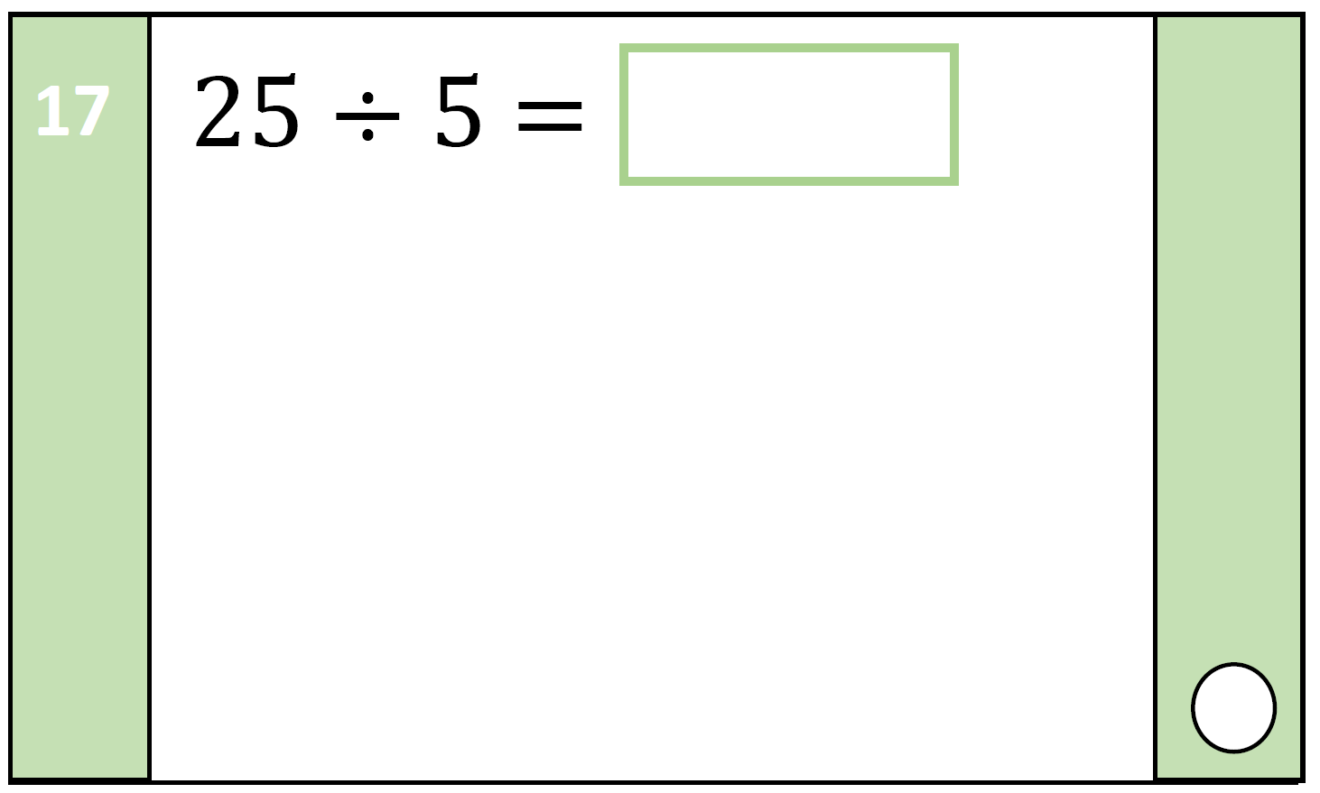
1 2 3 4 5 6 7 8 9 10 11 12 13 14 15 16 17 18 19 20
How will your 5 times table help you?

Slide 20
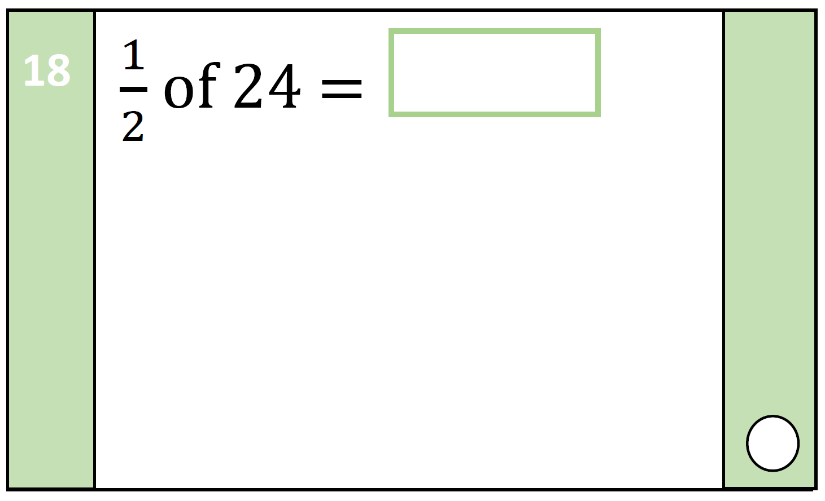
1 2 3 4 5 6 7 8 9 10 11 12 13 14 15 16 17 18 19 20
This fraction means half!

Slide 21
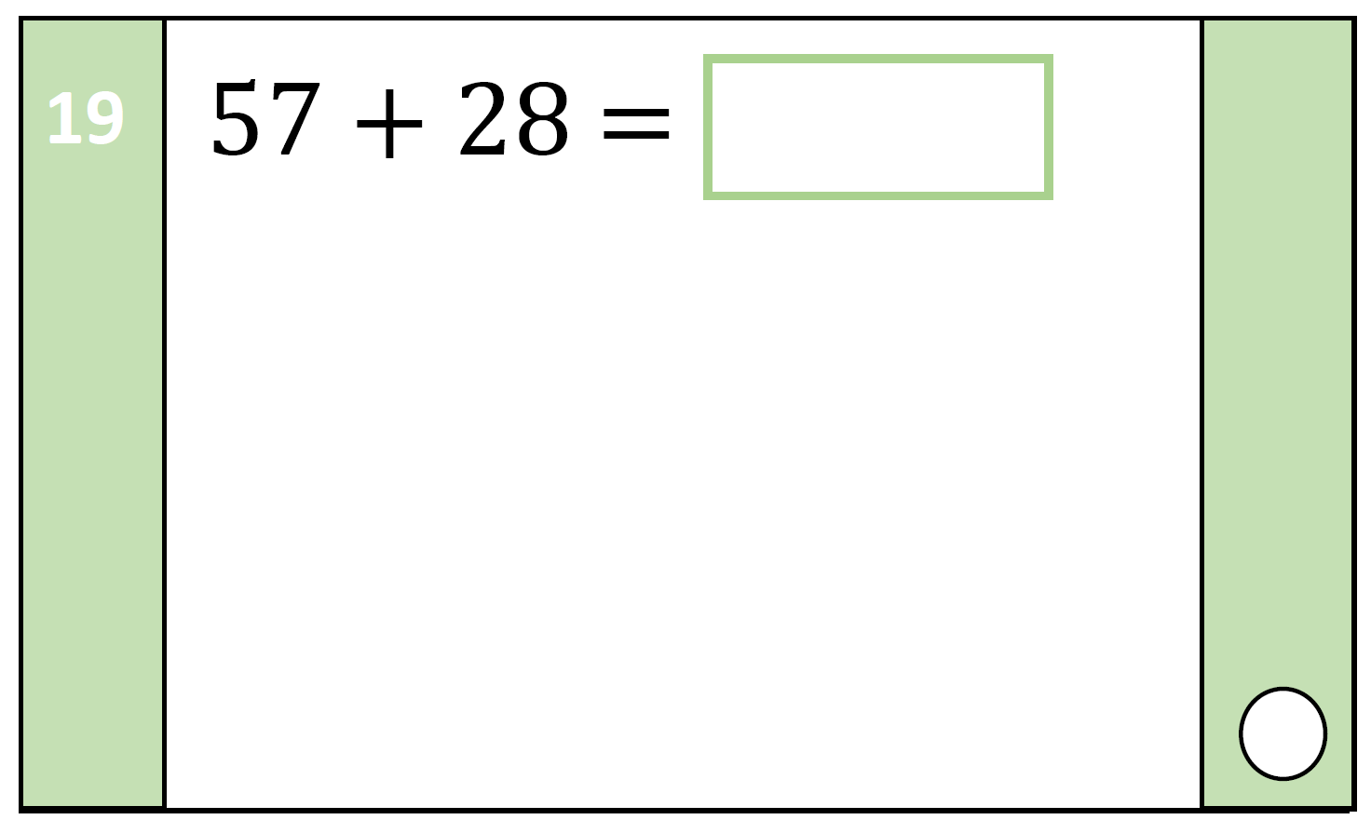
1 2 3 4 5 6 7 8 9 10 11 12 13 14 15 16 17 18 19 20
Which addition method did you use?

Slide 22
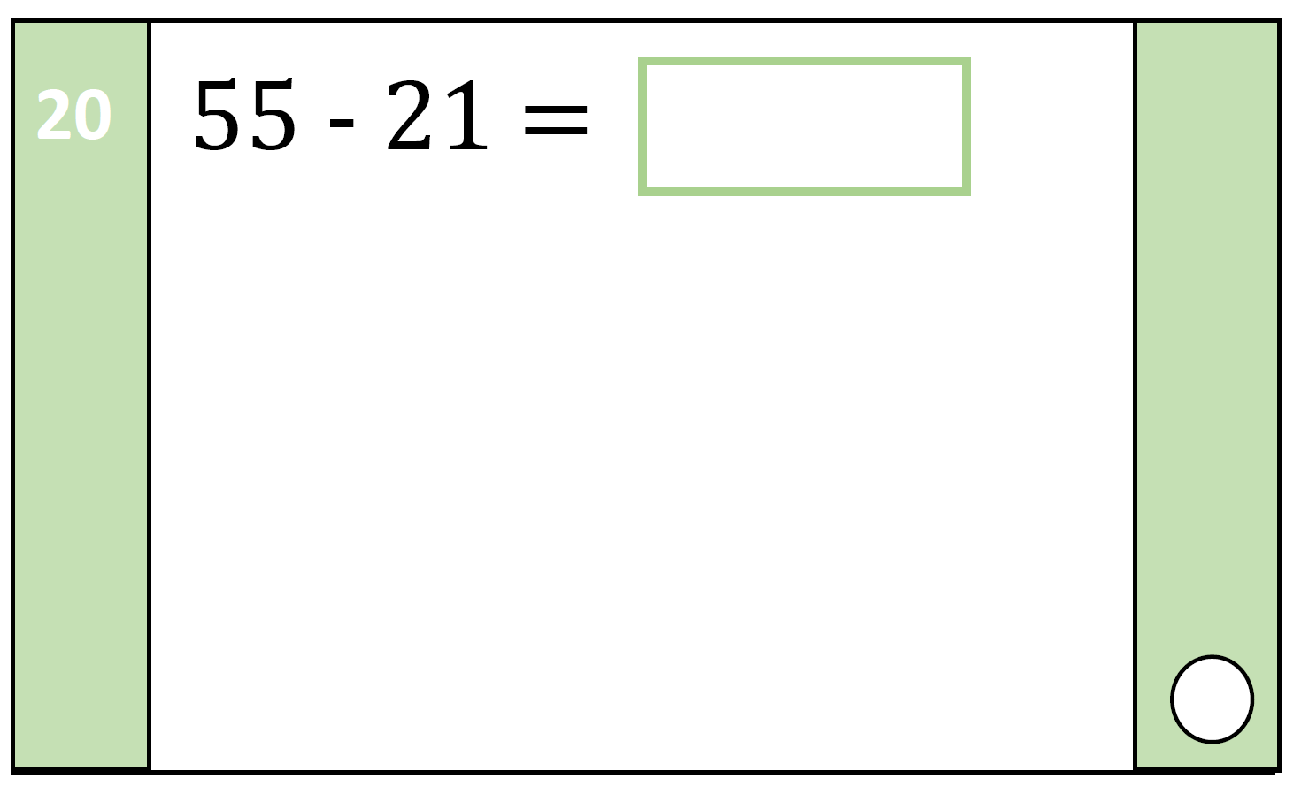
1 2 3 4 5 6 7 8 9 10 11 12 13 14 15 16 17 18 19 20
Which subtraction method did you use?

Slide 23
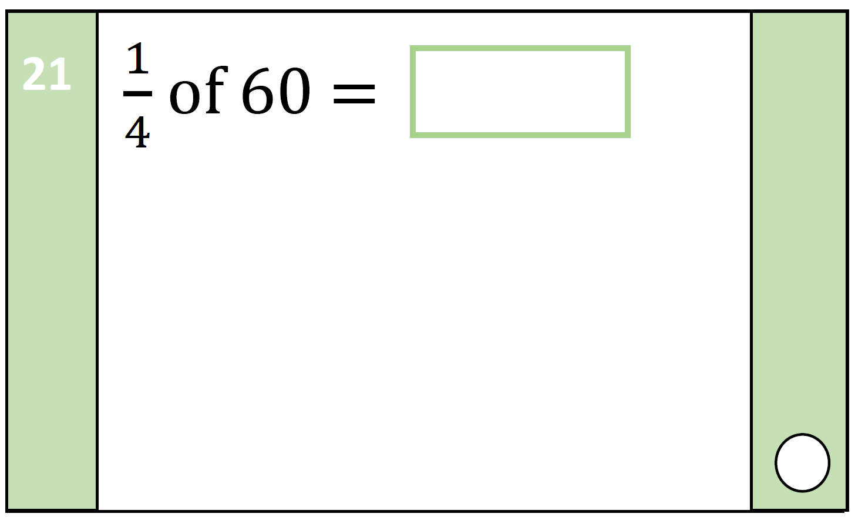
1 2 3 4 5 6 7 8 9 10 11 12 13 14 15 16 17 18 19 20
This fraction means one quarter!

Slide 24
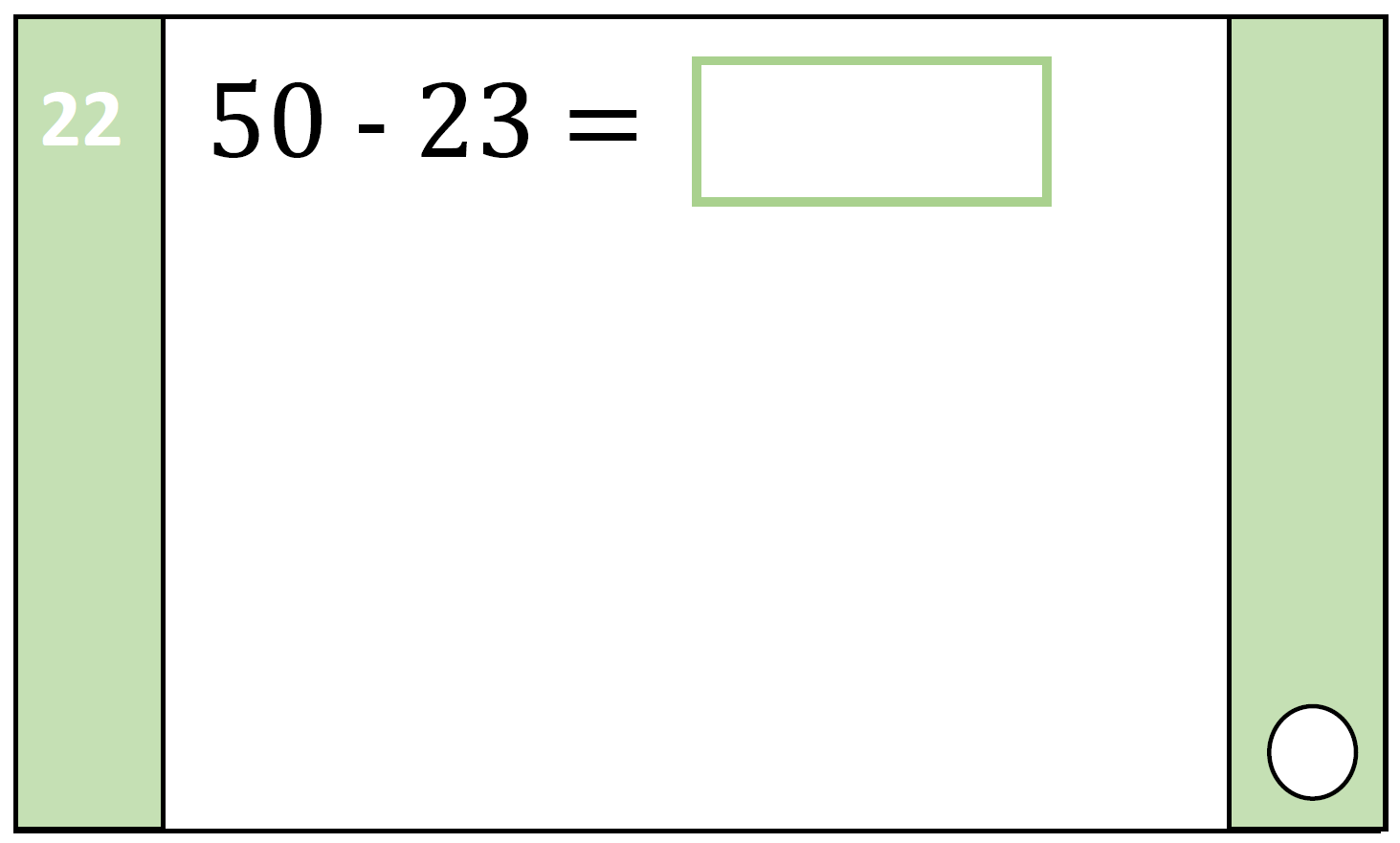
1 2 3 4 5 6 7 8 9 10 11 12 13 14 15 16 17 18 19 20
You can’t take 3 away from 0! What will you do?

Slide 25
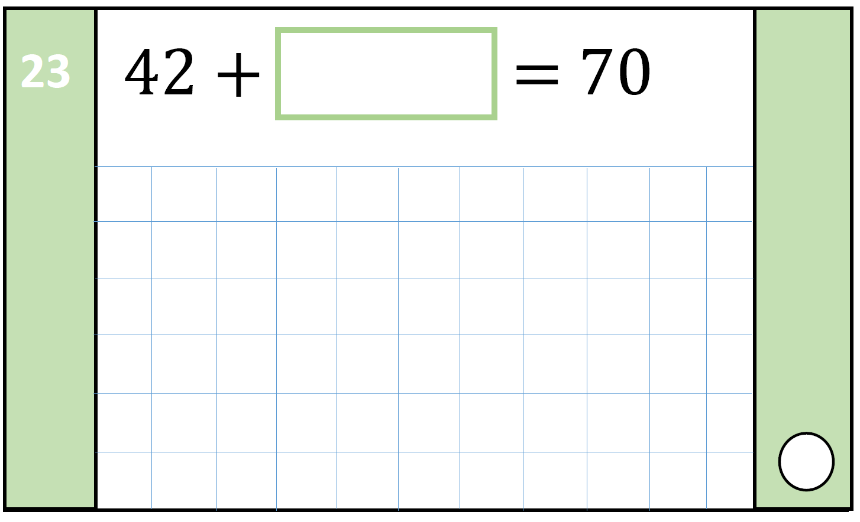
1 2 3 4 5 6 7 8 9 10 11 12 13 14 15 16 17 18 19 20
Inverse to the rescue!

Slide 26
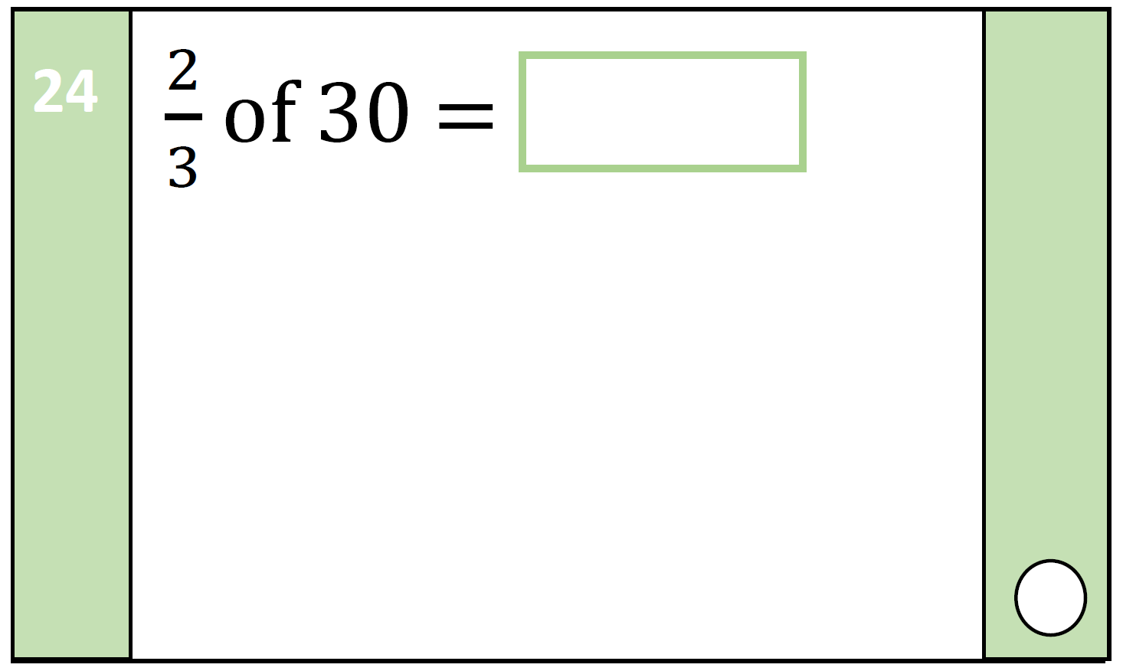
1 2 3 4 5 6 7 8 9 10 11 12 13 14 15 16 17 18 19 20
This fraction means two thirds!

Slide 27
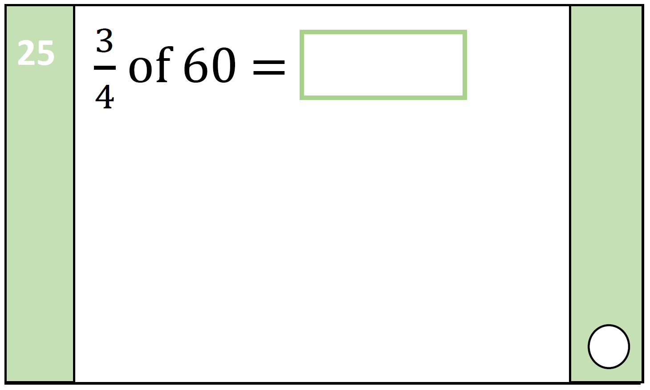
1 2 3 4 5 6 7 8 9 10 11 12 13 14 15 16 17 18 19 20
How do you know how many groups there are? The numerator or
the denominator?

Slide 28
Congratulations! You have completed KS1 Arithmetic Paper A!
The accompanying paper to this PowerPoint is available to download from the TES resources website:
https://www.tes.com/teaching-resource/ks1-sats-2016-arithmetic-paper-1-sample-a-with-answers-11217883
More papers are also available! Please don’t forget to leave us feedback!
ANSWERS ARE ON THE FOLLOWING SLIDE!

Slide 29
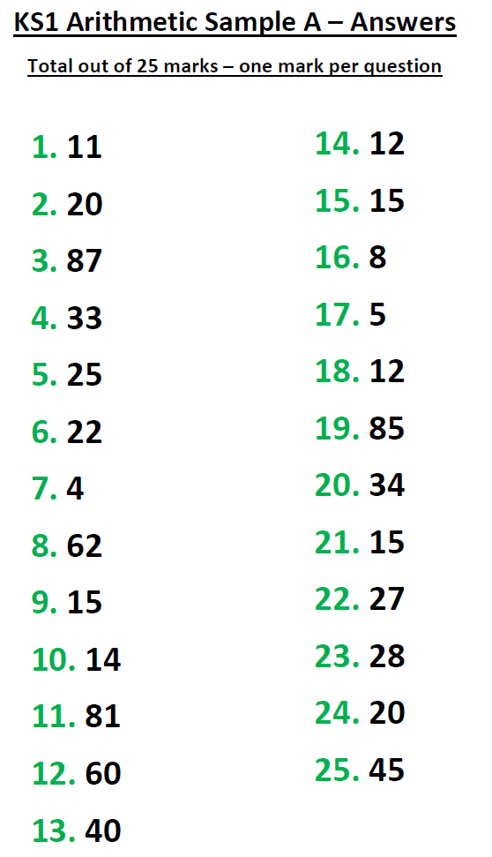
These answers can be used as an aid during the PowerPoint either for marking the test or mini plenary activities.
Please visit www.tutortastic.co.uk for more details or email office@tutortastic.co.uk to have a tutor visit your school or home!

