Slide 1
Key Stage Two
Statutory Assessment Tests (SATs)

Slide 2
Standards
Children will be graded according to the following criteria:
Working towards the expected standard (WTS)
Working at the expected standard (EXS)
Worked at greater depth (GDS)
Notes:
In order to assess the children’s standard at the end of the year, the teachers will use their teacher assessment and the SATs tests. Teacher assessment will be completed for writing and will include internal and external moderation. The expected standard for writing will have to be completed entirely and is not a best fit scenario.

Slide 3
Tests Taken
One Reading Paper
Three Maths Papers
One Spelling, Grammar and Punctuation Paper
One Spelling Paper
Possible Science Papers
All tests MUST be taken in MAY
Notes:
In addition to this, the children will sit tests. These tests will form the levels given to each child in these areas. They will be arranged on a standardised level.

Slide 4
Tests Scores
Test scores are reported as ‘scaled scores’.
It is planned that 100 will always represent the ‘national standard’
Each child’s raw score will be converted into a scaled score, either at, or above 100
If a child achieves a scaled score of 100, they will be deemed to achieved the expected standard
If children achieve a scaled score of 110 or more, they will be deemed to achieved greater depth
Notes:
Teachers are provided with conversion tables to convert the raw score into the scaled score.

Slide 5
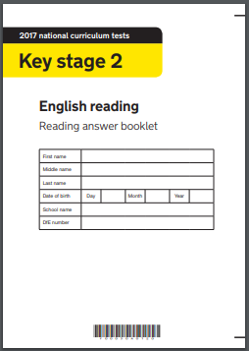
Reading
Notes:
Share reading papers.
Talk about:
Stamina
Need to read every night
Reading of a range of genres
Talking about the books they read
Content domains – share question stems booklet.
60 minutes – Three texts (20minutes per text)

Slide 6
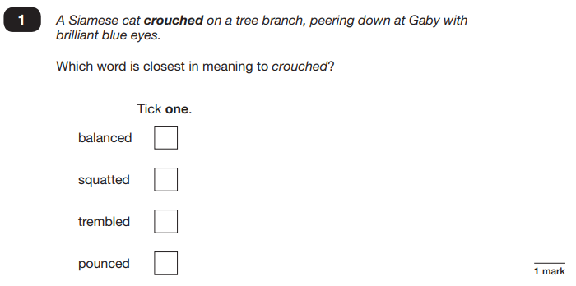

Slide 7
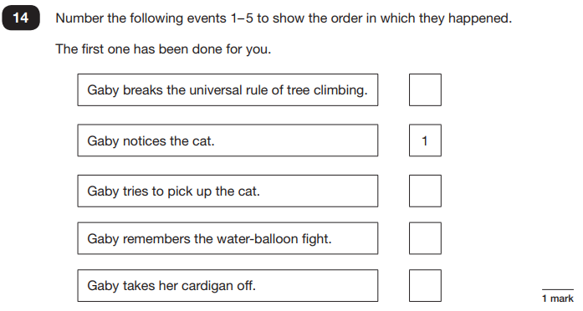

Slide 8
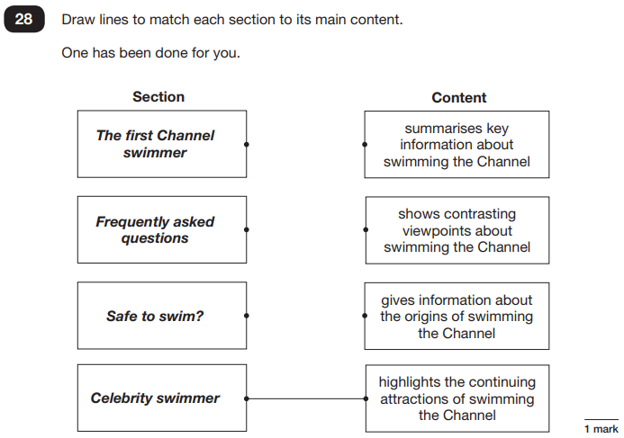

Slide 9
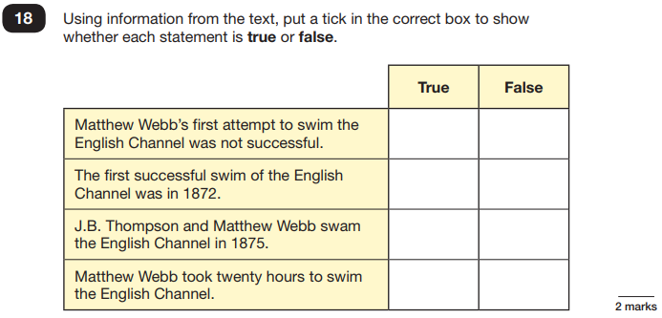
True or False Statements

Slide 11
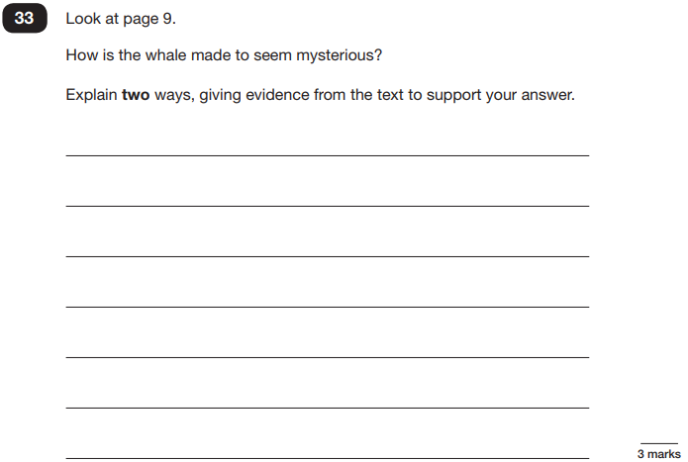

Slide 12
How to support your child in reading

Slide 13
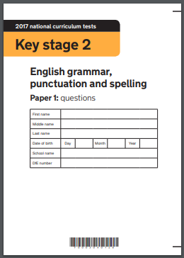
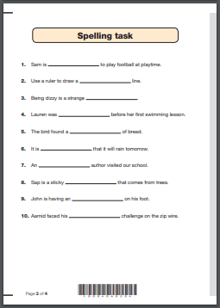
Spelling, Punctuation and Grammar
Notes:
Share an example of the test.

Slide 14
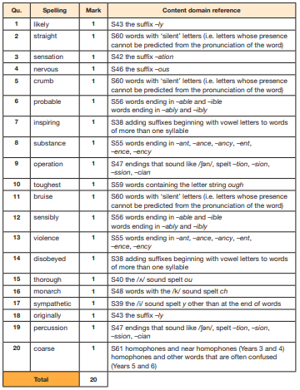
Notes:
2017 spellings

Slide 15
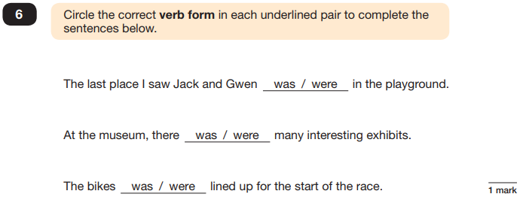
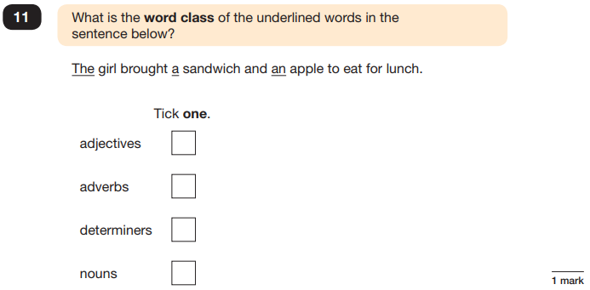

Slide 16
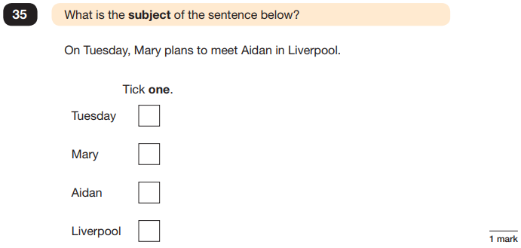

Slide 17
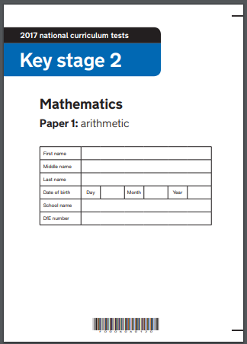
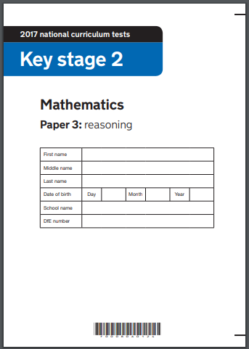
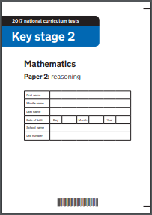
Mathematics

Slide 19
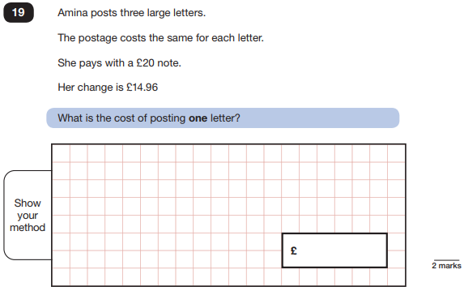

Slide 20
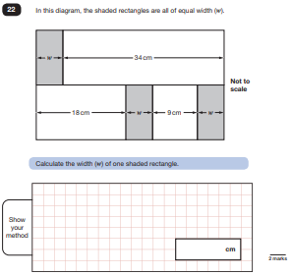
Notes:
Share framework for maths

Slide 22
Writing
Teacher assessed
Over a series of pieces of writing
Given criteria used to make judgements
Reading is important as this needs to come through the children’s writing
Handwriting is very important and homework should be encouraged to be in a cursive script
Serious weakness?
Notes:
Share exemplar materials for the different standards so the parents can see what the children need to do.
Share framework for writing.

Slide 23
How to help your child in writing

Slide 24
How to help your child

Slide 25
How the tests will be administered
In the school hall, year 6 classroom, library, computing suite
Children placed due to need
Mr Duckett will read the spelling test paper to children
Monitored by Governors (Possible external moderation)
Teacher assessment moderated by Mrs Narraway and Mr Duckett.

Slide 26
When?
Monday 14th May | Tuesday 15th May | Wednesday 16th May | Thursday 17th May | Friday 18th May
SPAG Test 1 – Short Answers Test 2 – Spelling | Reading Paper 1 | Mathematics Paper 1 – Arithmetic Paper 2 – Reasoning | Mathematics Paper 3 – Reasoning | Science Internal levelling

Slide 27
Holidays
Notes:
Highlight the fact that SATs are a national test and that attendance is essential.
Emphasise that the dates are set and that holidays should not be organised in term time – enough warning has been given.

