Slide 1


Year 4
PGL April 2026

Slide 2
When and Where?
Boreatton Park, Baschurch, Shrewsbury
Wednesday 22nd April 2026 to Friday 24th April 2026.
The children will leave school at 10am and arrive Boreatton Park around 12.00 and will get settled in. We will leave Shrewsbury on the Friday, departure will be around 13.00 so hopefully we should be back to school by the end of the school day.
If there is any delay we will make sure a message is sent out.

Slide 3
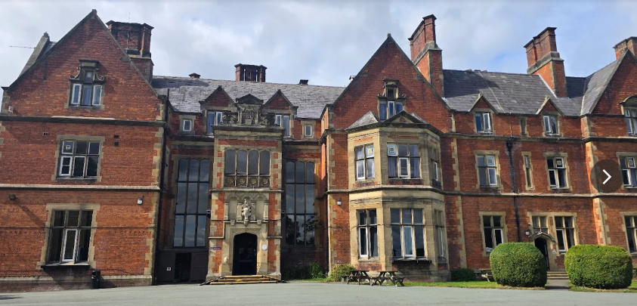

Slide 4
What will happen when we get there?
The children will arrive around 12pm.
They will meet their course leader.
They will have lunch at the centre.
They will be taken to their dorms.
Children will be asked to make their own beds.
They will be taken out to take part in their first activity with the class split into 3 groups. The course leaders will lead the activities but school staff will also be with them.

Slide 5
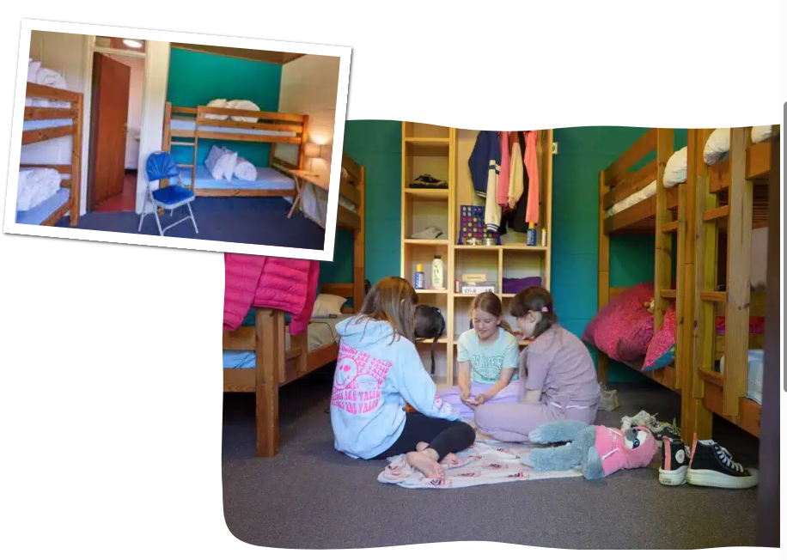
Tall timbers lodges

Slide 6
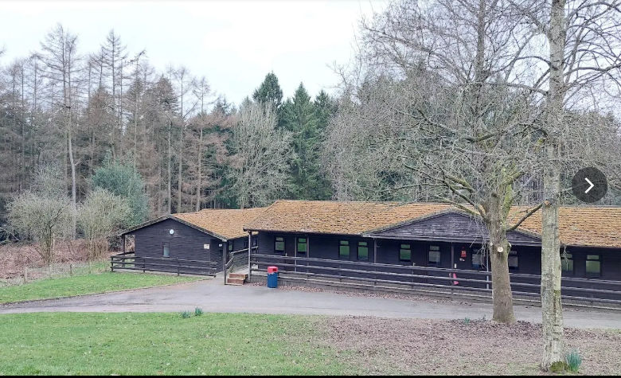

Slide 7
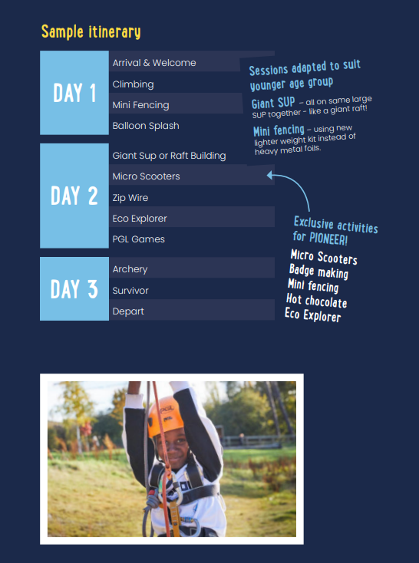
What types of activities might we do?
Nightline
Raft building
Problem solving
High ropes
Campfire
Archery
Leap of faith
Paddleboarding
Kayaking

Slide 8
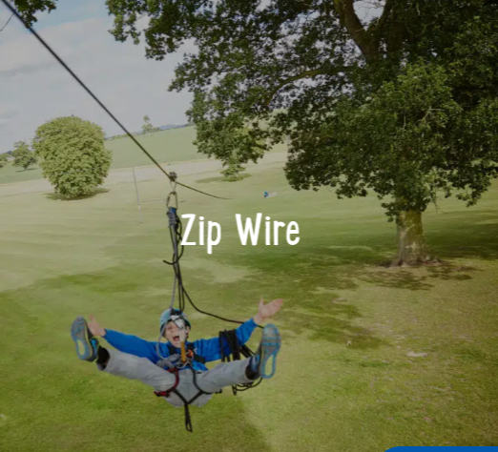

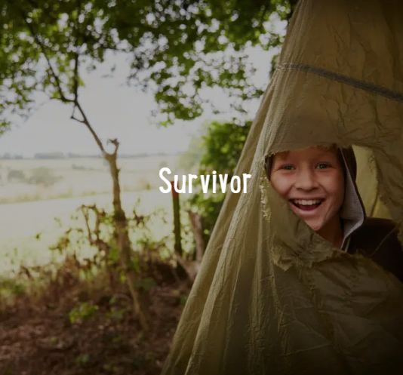


Slide 9
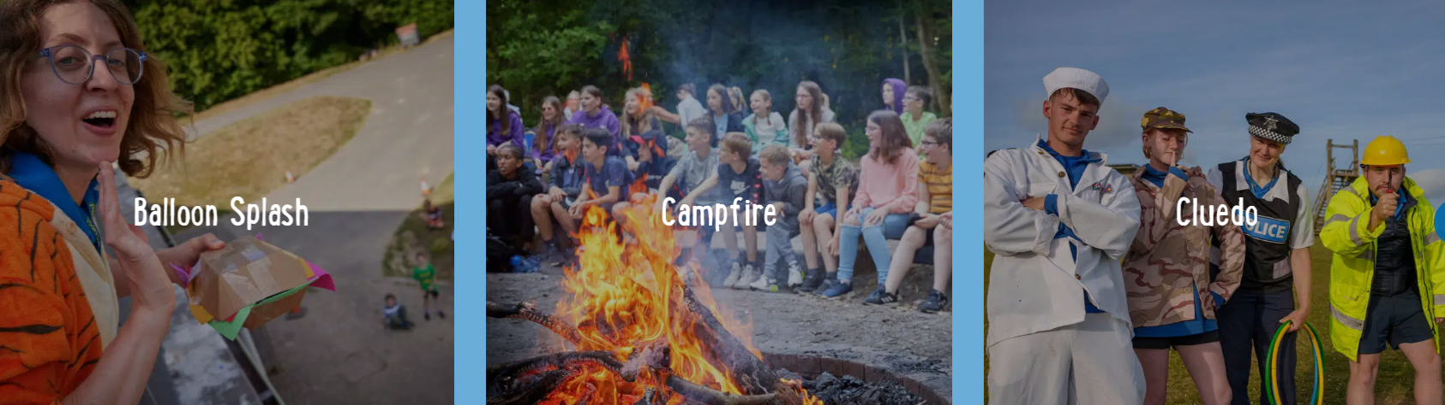
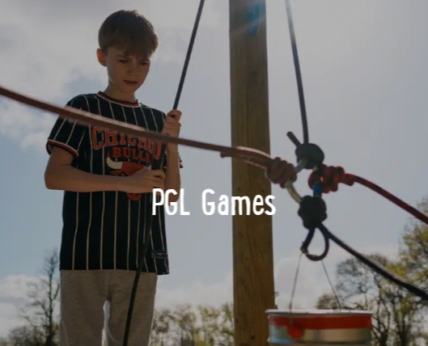


Slide 10
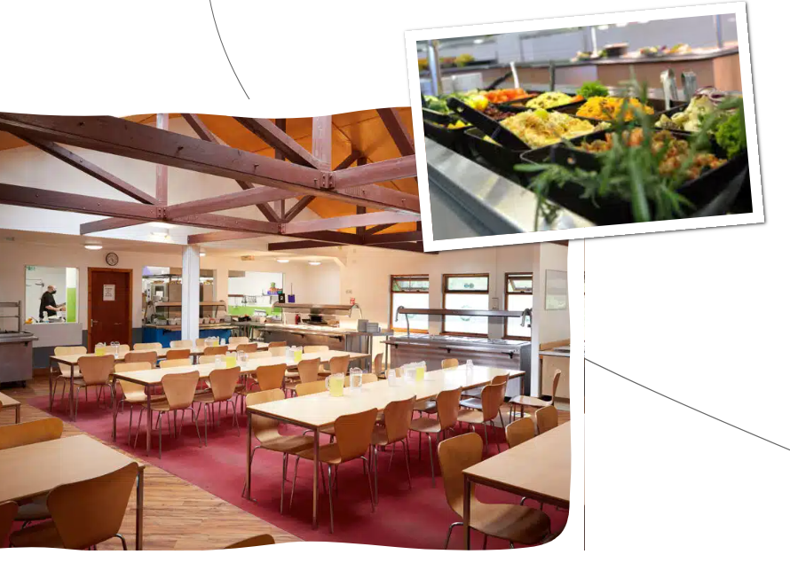
Meal times
The children will be provided with 3 meals throughout the day – breakfast, lunch and tea. Each school has an allocated time so we must be prompt at getting to the canteen so we do not miss our slot.
If you have informed us that your child has any dietary requirements, this has been passed on to Boreatton Park and any dietary needs will be catered for during our stay.

Slide 11
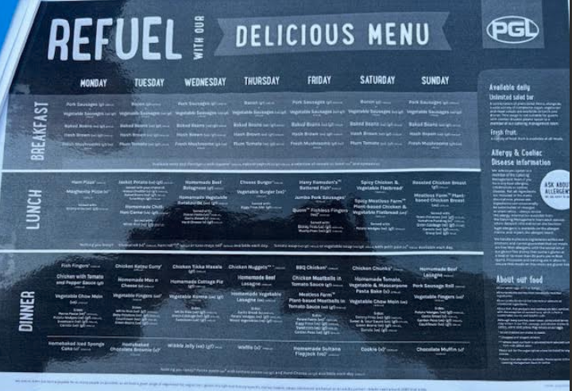

Slide 12
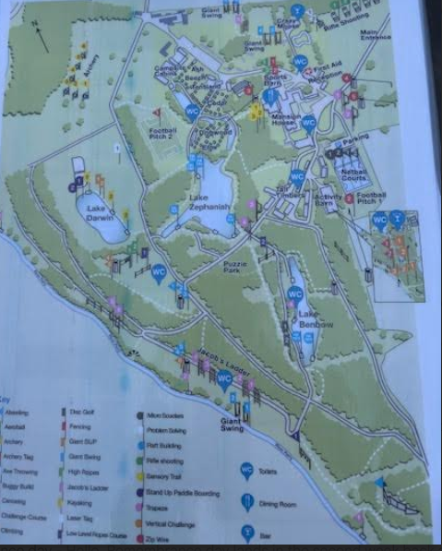

Slide 13
What can/can’t we take?
There is a shop at Boreatton Park where the children can purchase drinks and snacks as well as souvenirs – please only bring £10- £15.
You can bring a favourite teddy.
Do not bring any electronics – switch, phones, iPads, tablets etc. If any are taken they will be kept by Mrs Parkinson in a safe place until we return home.
Don’t take expensive or cherished jewellery, expensive or favourite clothing or shoes/trainers, they will get wet, muddy, dirty and possibly lost.

Slide 14
What shall we pack?
When packing your case, you may want to consider the following:
Sleeping bag and pillow
Towel for shower
Toiletries bag containing: toothbrush, soap, hairbrush, etc.
Night clothes/ teddy/ torch
Socks and underwear (I would suggest packing extra)
At least four t-shirts, at least one with long sleeves
Sweaters/ fleece
Trousers/tracksuit bottoms
Clothes for evening activities
Waterproof jacket and possibly waterproof trousers
Sturdy shoes / walking boots
Two pairs of trainers (one old pair which could get wet)
Large plastic bag for dirty clothes
Gloves, hat, scarf if weather is cold
Water bottle (plastic)- there are places around the park to refill this
Hat and sun cream (if it’s warm)
Slippers/ socks
Board game-eg Uno, toptrumps

Slide 15
Medication
If your child has any ongoing medical needs, particularly those which require the use of medication, a plan will be put in place prior to the trip. This plan may involve a meeting with yourselves to ensure that the needs of your child are met.
Any child requiring medication; including inhalers, travel sickness tablets etc; will need to complete a medication form prior to the trip to ensure that staff are aware of any medication being taken and in order to keep all children safe.

Slide 16
Conduct and expectations
As is always stated to the children during any activities, both on and off school site, we are representing Newchurch and our core values must remain at the heart of what we do.
There will be times when we are mixing with other schools, particularly during free time. The children will be supervised at all times, however, we will expect appropriate behaviour during our stay at Boreatton Park.
The children are going with staff that they know so if there are any issues they know they can come and inform us. Maintaining acceptable levels of behaviour, related to the physical and emotional safety for everyone, is essential.

Slide 17
Costings
The cost of the trip is £233.31 and will include all activities, two night’s accommodation and meals throughout the visit.
We recognise the financial strain that trips can put on families and work to reduce the cost in a number of ways, such as enterprise, procurement and allowing families to pay in instalments (5x £38.80 – Dec-April + deposit £38.91).
School does require a commitment to attending the trip for the trip to go ahead, as we are not able to financially cover the booking for a wider class if a large group of children did not want to go. If you are unsure, need advice or support, please do not hesitate to contact the office, Mr Duckett or Mrs Narraway.

Slide 18


