Slide 1
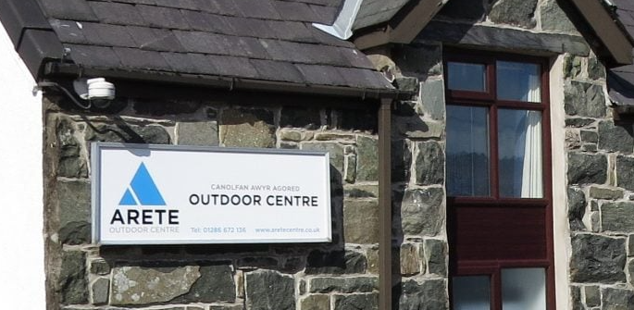
Arete Residential
Year Six Social Story

Slide 2
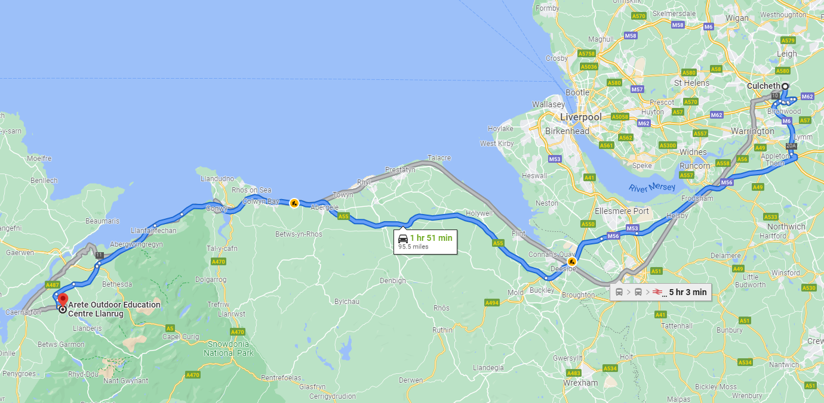
When and where are you going?
You are booked to go to the Arete Outdoor Education Centre from Monday 4th October to Friday 8th.
You will be going to the Arete centre in North Wales. The journey will take around 2 hours and will be via a coach.
https://www.aretecentre.co.uk/arete-centre-uk/

Slide 3
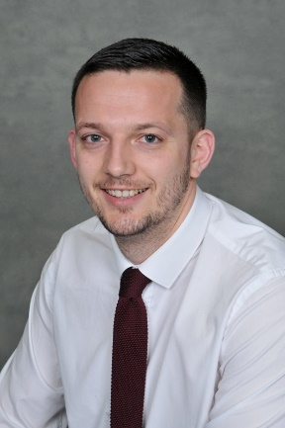
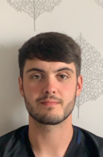
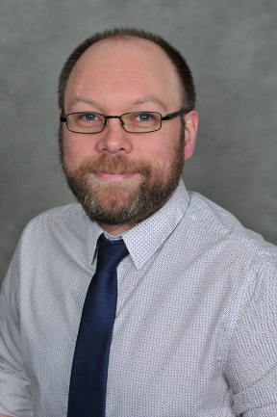
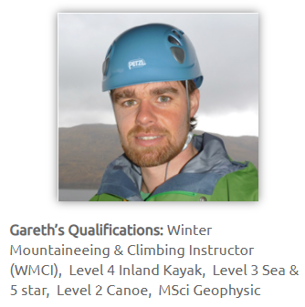
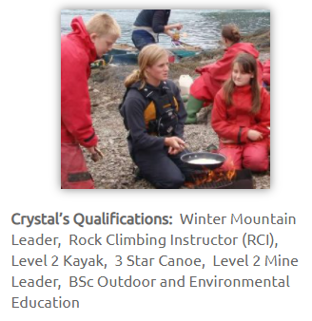
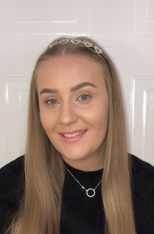
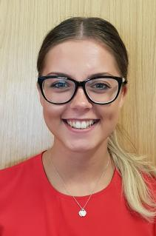
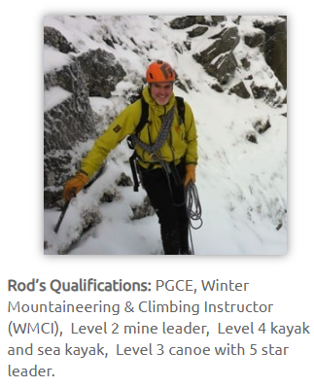
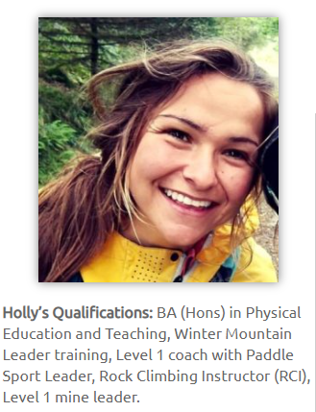
Who will be working with me?
You will be working with members of the Arete staff, but you will also have Newchurch staff with you throughout the day.
Arete Staff
Newchurch Staff
Your Arete staff might change depending on which activities you are doing. You can find more staff here:
https://www.aretecentre.co.uk/staff/
Mr Boon Mon - Fri
Mr Singleton Mon - Fri
Mr Duckett Mon - Fri
Miss Igglesden Mon - Wed
Miss Brinksman Wed - Fri

Slide 4
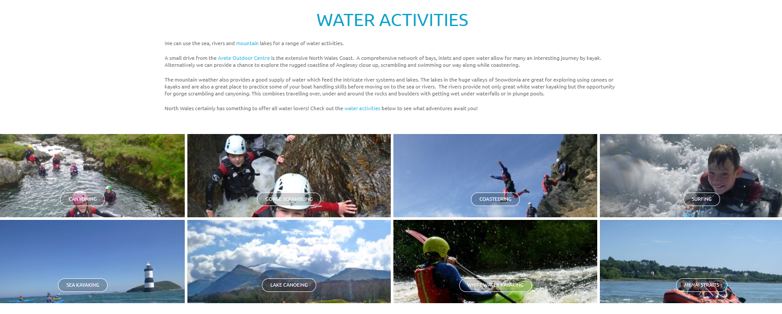
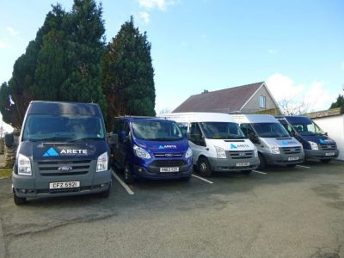
What will you do at Arete?
Your Newchurch staff will choose activities for your visit but they are weather dependent. The final choice of activity will be made by the expert teachers at Arete. The activities can last throughout the day and may be on land or on water. You will also have a night activity which will help you unwind before bed time. Activities can be 30 mins away from the centre and you will be driven there by Arete staff using the centre’s minibuses.

Slide 5
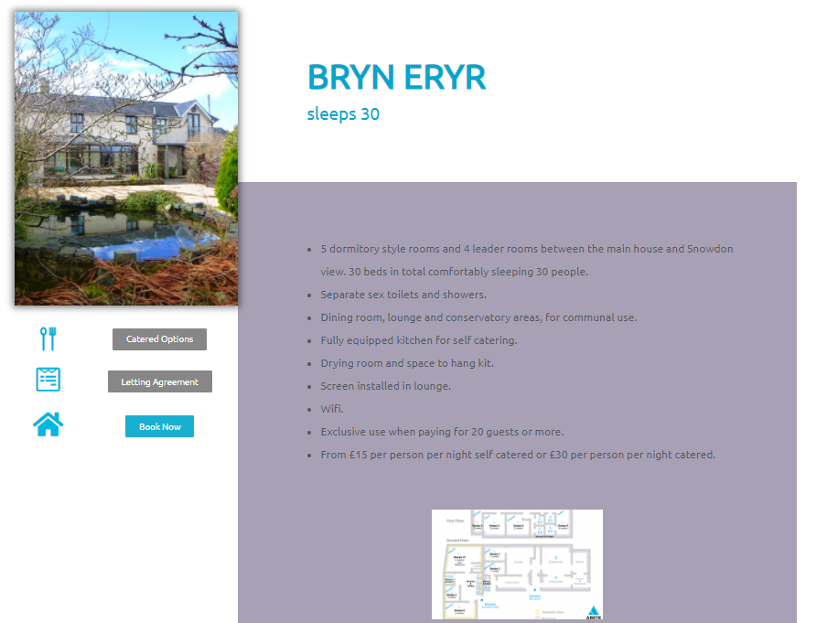
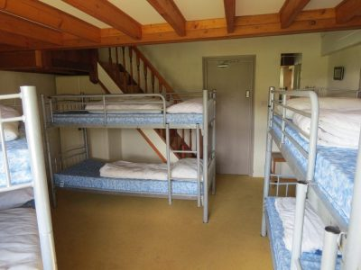
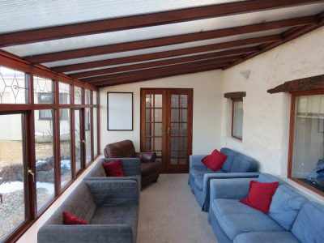
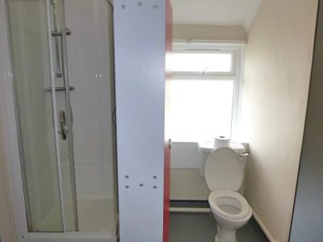
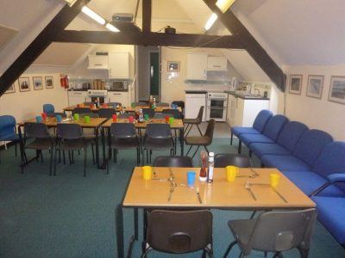
Where will you stay?
The accommodation at Arete is built around two buildings. Your school will sleep and eat in one of the buildings. You will be separated into dorms with Newchurch staff in rooms in the same building. The centre will be locked during the night and a member of the Arete staff will be contactable through the night. Arete staff will cook your meals but you will have roles to play to support creating lunches and tidying up.

Slide 6
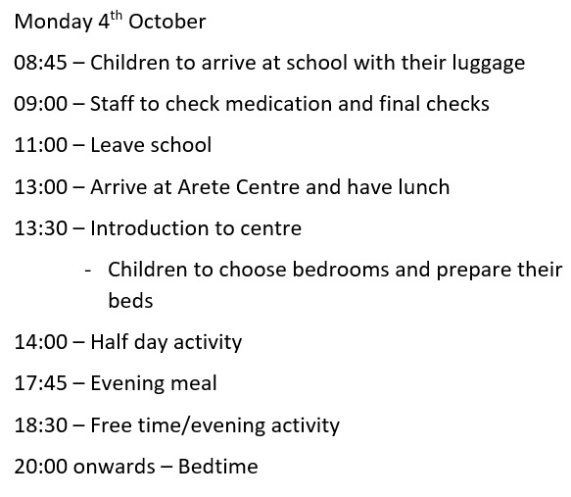
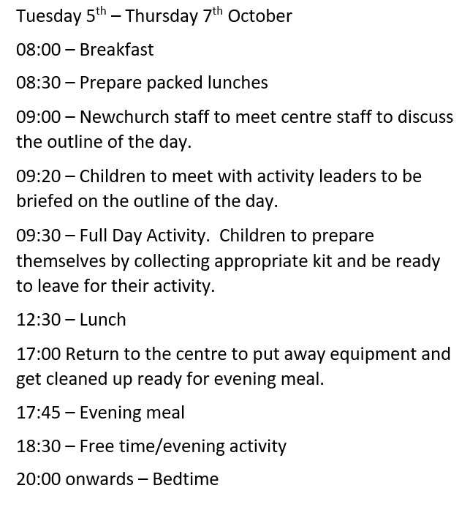
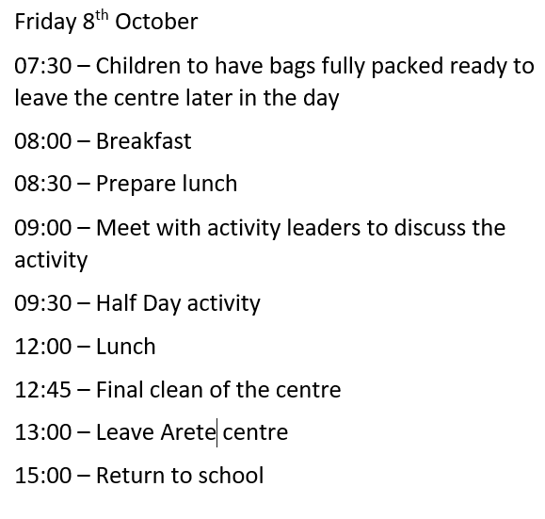
What will each day look like?
Our time on the residential will be an extremely busy one with activities to keep you busy from breakfast until bedtime. Below is the itinerary for your trip.
Meal Times
We are very aware that a number of children have dietary needs/allergies. Rest assured that we have a list of all of these individual requirements and this information has been communicated to the Arete centre who will ensure your needs are catered for.

Slide 7
Will there be a shop?
There is a tuck shop on site where you will be able to purchase snacks as well as souvenirs to remember their trip. If you wish to bring money, we recommend that amount be no more than £10 and be placed in a labelled purse or wallet. Please do not put the money in an envelope as once they are opened, there may be issues in keeping your money safe – especially loose coins.

Slide 8
Will I be able to contact my family while I am away?
Absolutely! We understand that you will want to communicate with your family and we will ensure that throughout the week, you are able to have access to a device which will ensure that you can speak to your loved ones back home. This will likely take place in the evenings during free time. The staff with you at Arete with liaise with the office staff back at school who will inform your parents of when we expect to be able communicate with them. We will also be sharing as much of your experience as we can on Twitter so that they can see what you have been getting up to!

