Slide 1

Little Wandle
Phonics and Reading
Notes:
Welcome to our Transition meeting – hopefully, you will gain lots of information about the things that stay the same as your child moves on a year but also some information about any changes. We have worked with the School’s Parent Board to hopefully include everything that you need to be informed about.

Slide 2
What is Little Wandle?
Schools need to follow an approved phonics programme – Little Wandle is the closest to what we have used previously.
86% - passed phonics Screening Check in Year One last year.
It is a scheme for Reception, Year 1 to teach phonics and reading
Support for Year 2 children who don’t pass the screening check.

Slide 3
What does it include?
Daily phonics lesson 20 mins
Revisit and review, teach, practise and apply
Catch up sessions for children who might fall behind
3x week adult led reading sessions in groups.
Decoding skills, Prosody and Comprehension skills are taught.

Slide 4
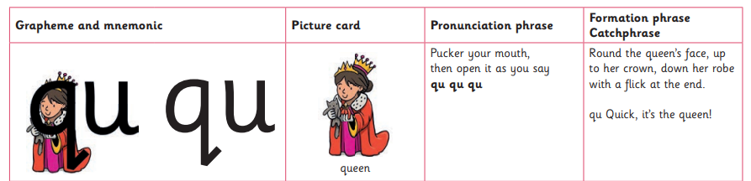
This is what children will learn in school. Usually one grapheme per phonics session.
Picture prompt to remind children - might be used when children are writing.
Prompts to help with pronouncing the sound.
Formation phrase – children will learn this as part of handwriting.

Slide 5
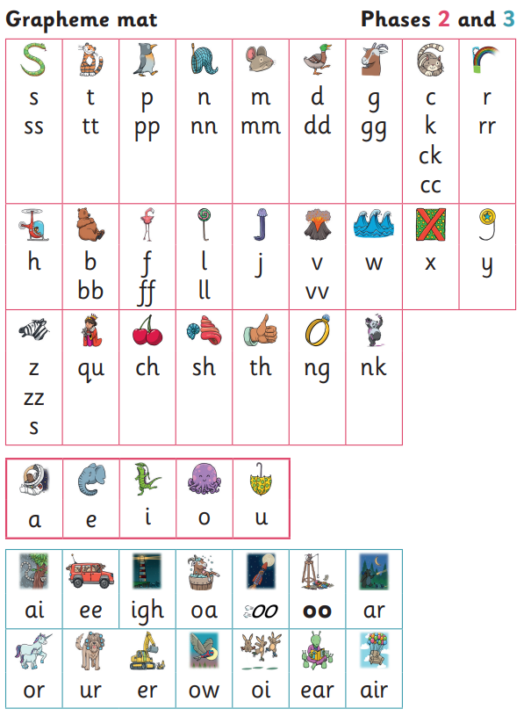

Slide 6
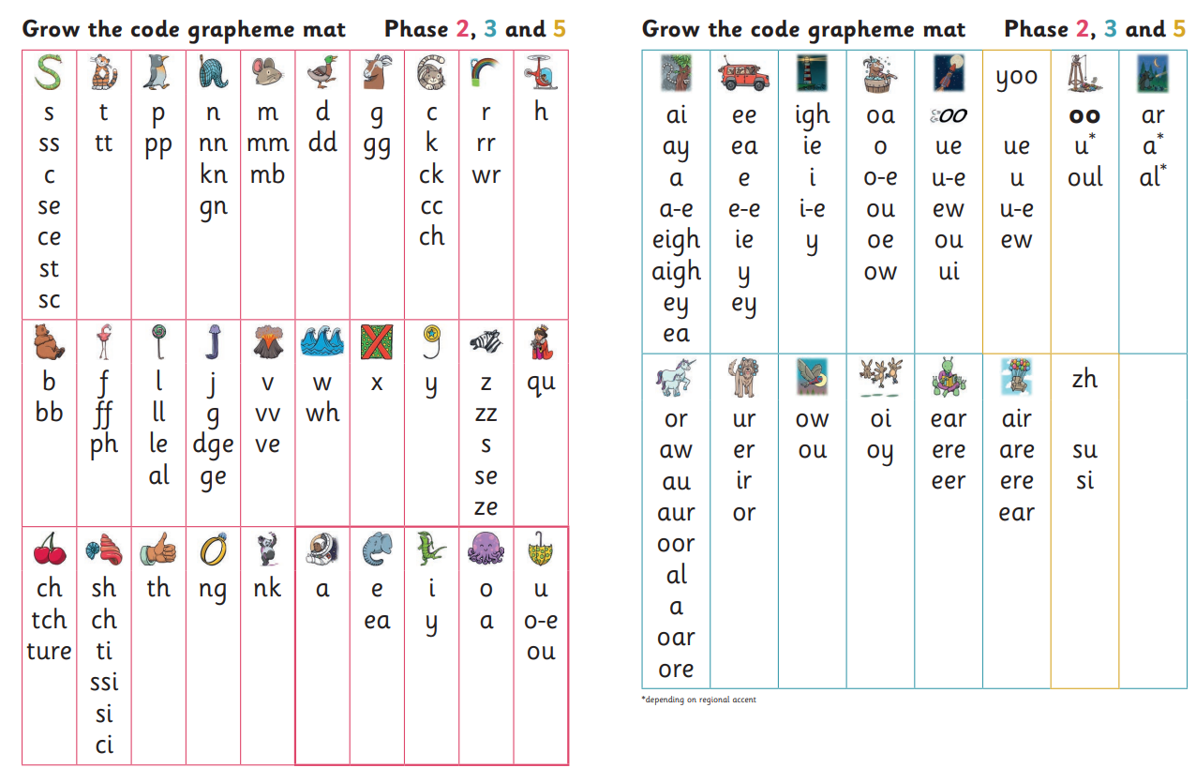

Slide 7
What is my role?
Reading at home – 1 book sent home at the correct phonics level for your child. This is to be read at least three times a week.
Online reading – book that your child is reading in school.
Reviewing sound mat with the children
https://www.littlewandlelettersandsounds.org.uk/resources/for-parents/

Slide 8
Year 1 Phonics Screening Check
40 words – real and nonsense
Children need to read at least 32 correctly to pass
Summer 2024

Slide 9
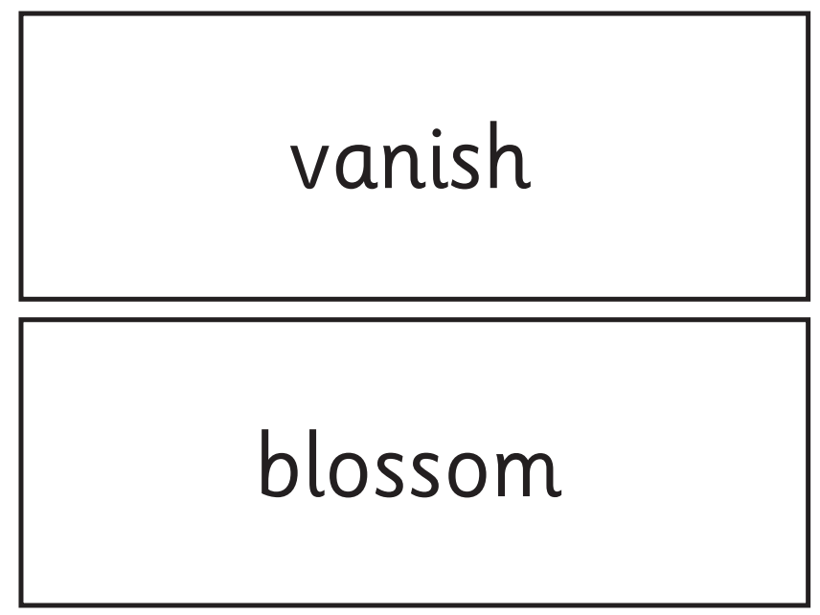
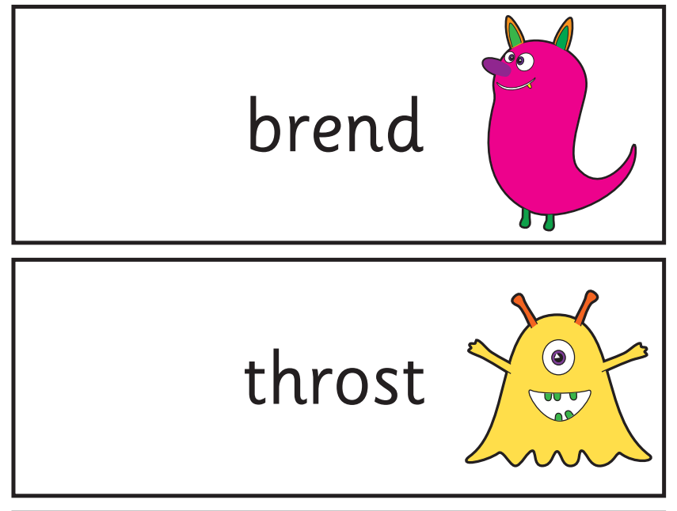

Slide 10
Little Wandle Phonics Workshop
Thank you for attending this afternoon.
If you have any more question please feel free to speak to Mrs Sizer or Miss Igglesden.

