Slide 1

e-safety and the hazards
of the communication age

Slide 2
Aim: to raise the awareness of Information and communication technology (ICT), the dangers for children and where we can gain professional support.
Objectives:
To develop the staffs understanding of the history of ICT and understand how children and young people use ICT.
To understand the risks of Information and Communications Technology for children and adults.
To understand where we can find support and information.

Slide 3
Warning
This presentation will deal with some facts linked to child abuse and how, if used unwisely or illegally, ICT can result in child exploitation and exposure to indecent or sexual content.
This is not a session in scaremongering or for shock, but to highlight the risks linked to using communications technology. It may deal with extreme cases, but all incidents are factual and therefore relevant.

Slide 4
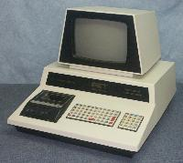


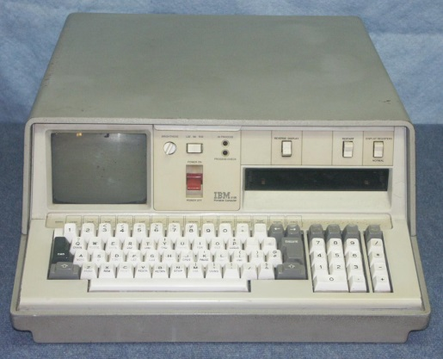
When was the Internet invented?
1981
1962
1990
Notes:
Rocket had computer equivalent to modern day toaster. 1962

Slide 5
Background facts:
The first conviction for uploading indecent images to the internet can be traced back to the 1990’s
First conviction in Britain for possessing indecent images was in 1874.
In 1996 less than 100 million users accessed internet.
In 2010 there were 1.5 billion internet users worldwide.
Approximately 42% of Internet users admit to visiting websites containing adult content.
Notes:
The internet did not create child exploitation or sexual dangers – first conviction was much earlier. It has made distribution and communication more prevalent and widespread.

Slide 6
The Triple A Engine
Accessibility – the safety of access is linked to greater feelings of power
Anonymity – creates highly protected ways of communicating with other adults, e.g sharing images
Affordability – low costs of digital photography and distribution
Cooper and Griffin-Shelley 2002

Slide 7
Background facts:
There are 4.2 million sex related websites (12% of the total)
One in five children aged under 17 years has visited pornographic websites.
Research by CEOP suggests that 1 in 5 children have been invited to a face to face meeting with a stranger

Slide 8
Background facts:
In 1990 – Home Office estimated there were approx 7,000 hardcopy indecent images of children (IIOC)
In 1995 – GMP – Seized 12 IIOC, all on video and paper
In 1999 – figure rose to 41,000 electronic form
Today unknown – police seized 2.5 million in a single collection
Notes:
Clearly distribution and access is the difference, but education is the key.

Slide 9
TASK 1:
What types of ICT do children use?

Slide 10









Notes:
Ipad / tablets
Iphones / smart phones
Game consoles
Smart TV’s
IPad touch
Laptops/ computer
Show children’s work from Y6

Slide 11
Background facts:
In 2001there were 23,000 web sites, and 40,000 chat rooms dedicated to child/adult sex
Referrals to CEOP increased 181% between April 2011 – March 2012
The illegal trade in imagery is estimated to be worth between $2-$3 Billion
IIOC appears to becoming more extreme, sadistic and violent.
Key legislation which deals with IIOC and ICT was updated in 2003, but the technological world continues to develop at a far quicker pace.

Slide 12
Sources of Abusive material
File sharing programmes ‘Peer to Peer’: such as ‘Napster’, ‘Kazaar’, ‘emule’ etc
‘Newsgroups’
E mail
Internet Relay Chat
Photo sharing sites, and ‘the cloud’
‘Private’ networks, such as ‘Wonderland’
Pay sites, such as ‘Landslide’

Slide 13
TASK 2:
What are the risks for young people using communications based technology?
Notes:
Bullying
Extortion
Grooming
Fraud
Abuse Mental and Physical
Exposure to indecent materials
Self harm issues/Self esteem issues - suicide

Slide 14
What do children fear the most when online?
Bullying
Paedophilia
Scamming e.g. money
Computer viruses

Slide 15
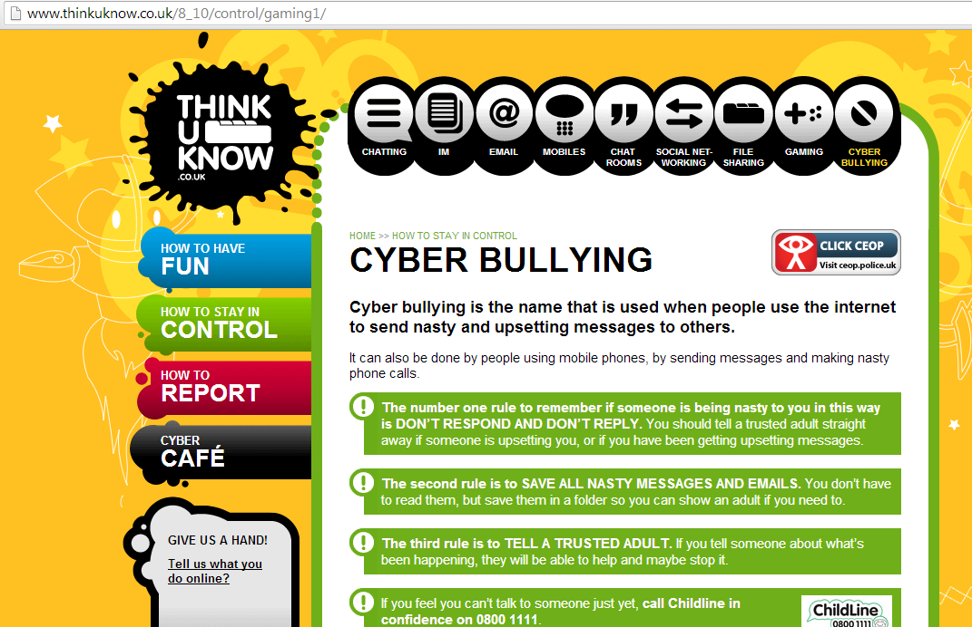
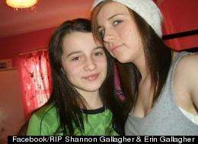

Cyber Bullying – Help & Advice
Notes:
High profile suicide cases linked to bullying.

Slide 16
Different types of internet offending
Possession
Making / downloading
Taking
Distribution
Possession with intent to distribute
Meeting a child following sexual grooming
Arranging or facilitating commission of a contact sex offence.
Causing or inciting or controlling or arranging or facilitating child prostitution or child pornography (Sexual Offences Act 2003)

Slide 17
Sexting
One of the more recent developments linked to the increase in mobile phones, involves the sending of nude or indecent images via text.
This is often done from child to child and can be as young as lower juniors with average age for getting the first mobile phone now being 8 years old in the UK.

Slide 18
Social Media and keeping safe
https://www.thinkuknow.co.uk/parents/Primary/Conversation-Starters/Go-to-the-movies/Jigsaw/
Children need to know
How to set their profile to private. – Updates can affect privacy settings.
They should only talk to people they know and trust in the real world.
That you are there to support them.
How to report anything that upsets them.
Consider legal ages (Facebook = 13 years old, Skype account = 13 years old) {Children over 13 can be classed as being of consenting age, but not below}
Notes:
How to set their profile to private.
They should only talk to people they know and trust in the real world.
That you are there to support them.
How to report anything that upsets them.

Slide 19
Supporting children and young people in the safe use of technology
Not everything you read or see online is true and not everyone you meets is who they say they are.
Never meet someone offline who you have met online
Know what to do it you are being cyberbullied (beatbullying website)
Know what to do if someone you know has been groomed online – click CEOP

Slide 20
Supporting children and young people in the safe use of technology
Know and understand the safety features online
Keep your usernames and passwords private
Keep your profile private
Never give out personal information online
Keep up to date

Slide 21
SMART
S – SAFE Keep safe by being careful not to give out personal information – such as your name, email, phone number, home address, or school name – to people who you don’t know online.
M – MEETING Meeting someone you have only been in touch with online can be dangerous. Only do so with your parents’/carers’ permissions & when they can be present.
A – ACCEPTING Accepting e-mails, IM messages or opening files from people you don’t know or trust can be dangerous – they may contain viruses or nasty messages.
R – RELIABLE Someone online may be lying about who they are, and information you find on the internet may not be reliable.
T – TELL Your parent, carer or a trusted adult if someone or something makes you feel uncomfortable or worried.

Slide 22
Stopping Internet Offending
CEOP - Child exploitation and online protection centre
Stop It Now / Lucy Faithful
Virtual Global Taskforce
Internet Watch Foundation
Local Police
Children’s Services

Slide 23
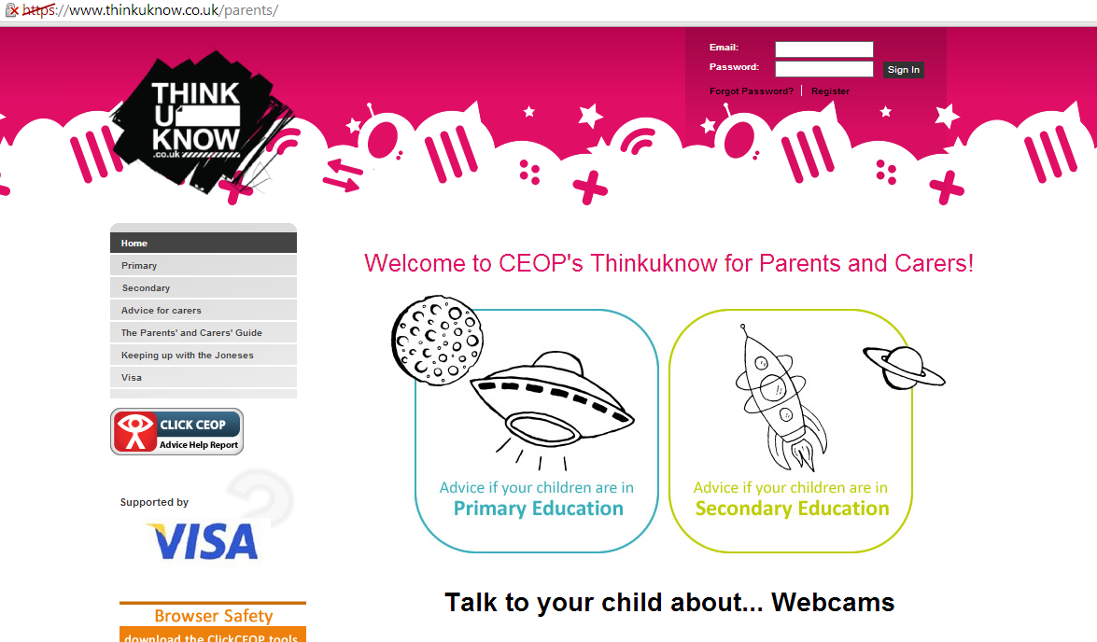

Slide 24
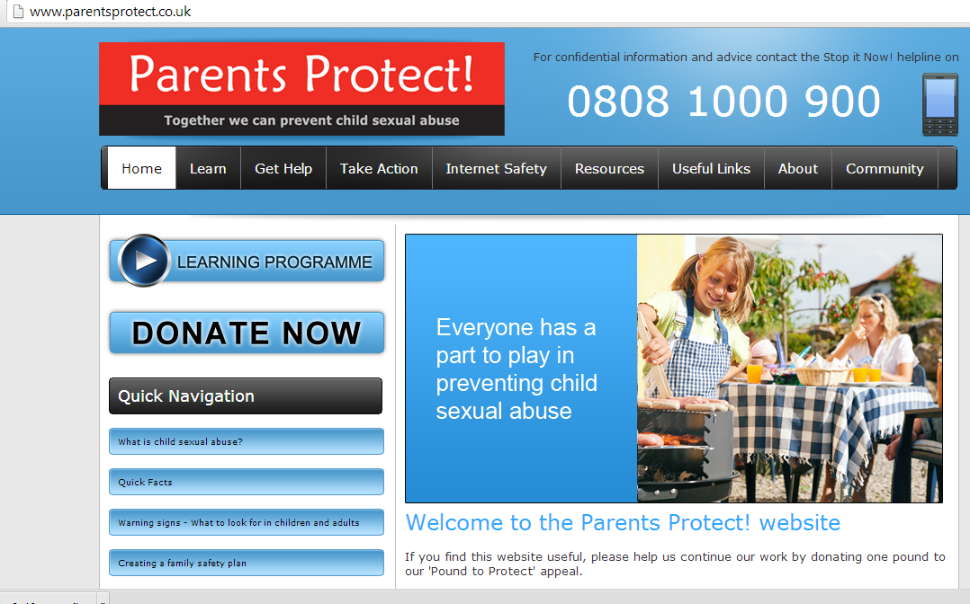

Slide 25

www.parentsprotect.co.uk
www.thinkuknow.co.uk
www.lucyfaithfull.org.uk
www.kidsmart.org.uk

