Slide 1
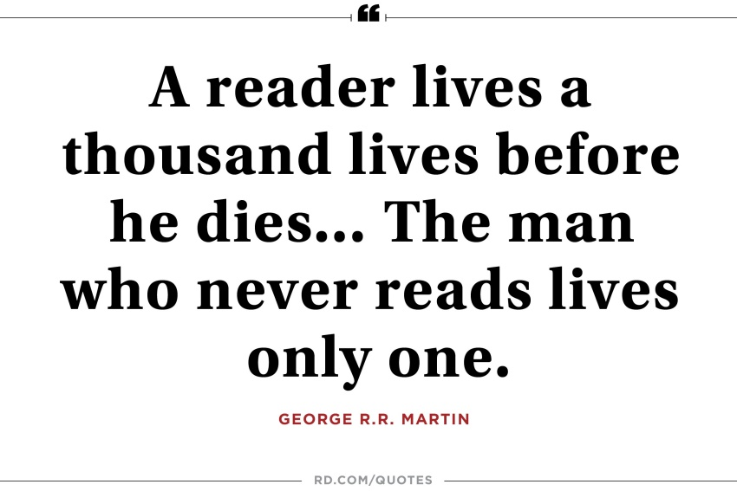
Reading Inference
Parent Workshop

Slide 2
Structure of the session:
Time | Focus
1:30pm – 2:10pm | Reading workshop with a focus on developing inference skills.
2:10pm – 2:40pm | Reading within the classroom with a focus on inference skills – seeing it in practice.
2:40pm – 2:50pm | Play time and refreshments for parents.
2:50pm – 3:10pm | Reading for pleasure – a chance to sit with the children and share a story.

Slide 3
Aims:
To ensure that you are clear about what inference is
To look at using inference in pictures and animation
To look at how inference skills are developed through books

Slide 4
Making an inference involves using what you know to make a guess about what you don't know, or reading between the lines. Readers who make inferences use the clues in the text along with their own experiences to help them figure out what is not directly said, making the text personal and memorable.

Slide 5
Observations occur when we can see something happening. In contrast, inferences are what we figure out based on an experience. Helping children understand when information is implied, or not directly stated, will improve their skill in drawing conclusions and making inferences.

Slide 6
Ways to make inferences
Pictures
Animation and film
Text
There are many different ways to develop inference skills without using a text. Obviously, we want the children to infer based on what they have read and use the text to support their inferences but some children need to simply learn to infer. Here a few ideas you could try!

Slide 7
Picture Books
Using post it notes to help think about what the character is thinking based initially on the picture and then on the text.
Select a picture book of your choice. Take some post it notes and make inferences based on what you have seen in the picture. Use the phrase, ‘I think____ because_____.

Slide 9
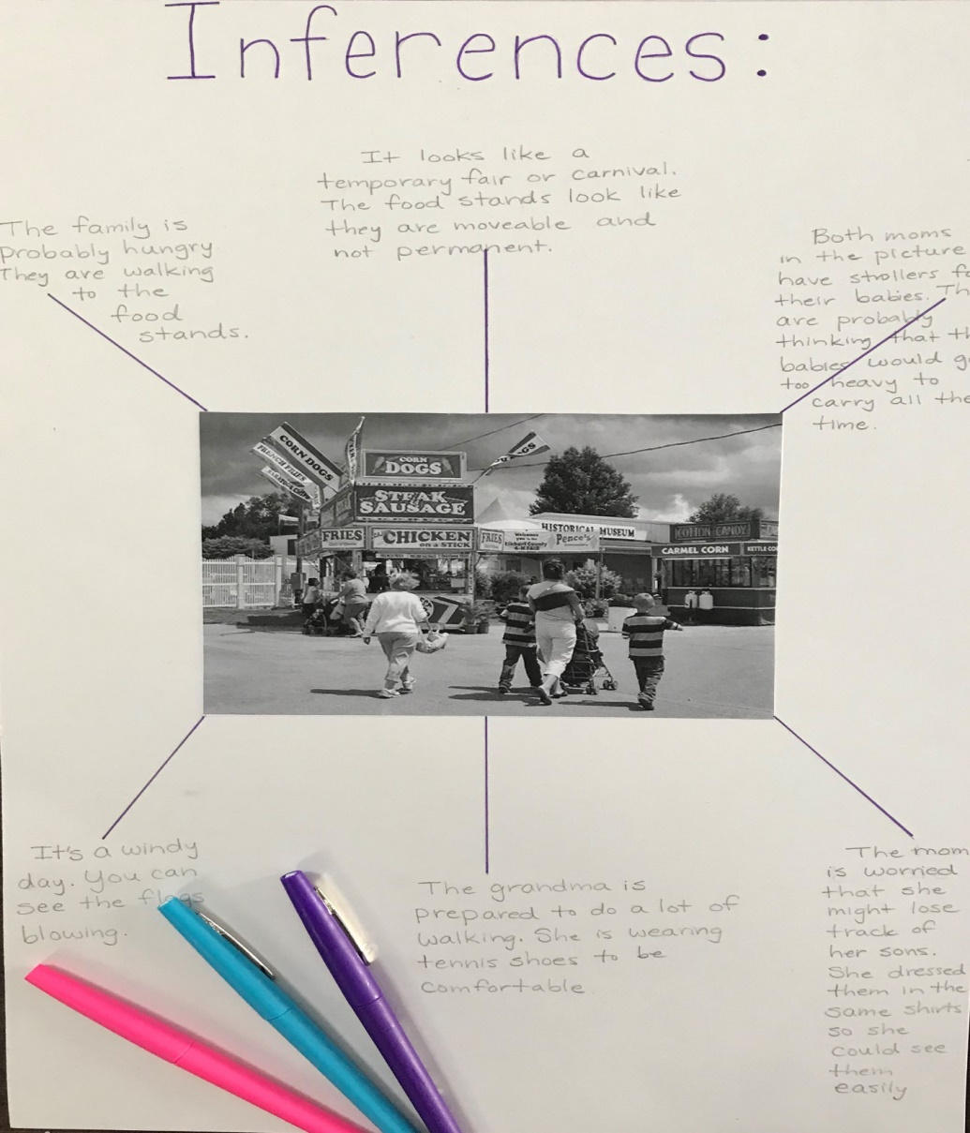
Inferences
from pictures
Select a picture from the pile and look at what you can infer from it. What evidence supports your inference. Use the phrase, ‘ I think ______ because_______.

Slide 10
Using Pixar Movies
Watch the animation. What impression do you get of Alma? Support your inference with evidence from the animation. Use the phrase, ‘I think____ because______.

Slide 11
Scaffolding Children’s Inferences

Slide 12
Year 1
discussing the significance of the title and events
Year 2
making inferences on the basis of what is being said and done
KS2
drawing inferences such as inferring characters’ feelings, thoughts and motives from their actions, and justifying inferences with evidence
making inferences on the basis of what is being said and done
answering and asking questions

