Slide 1
Return to School
Reception Social Story

Slide 2
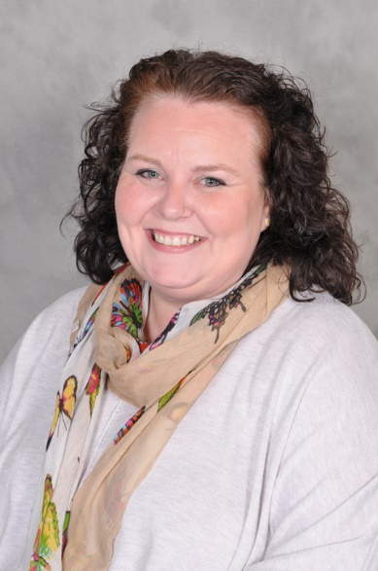
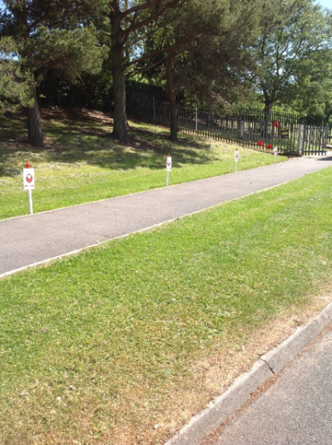
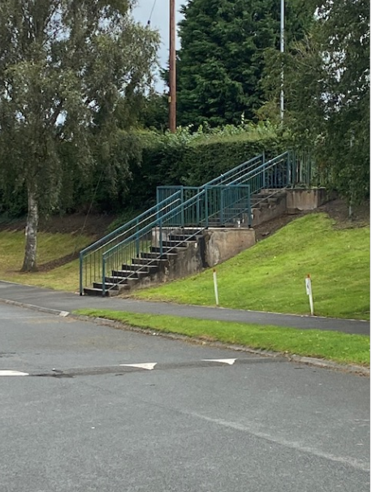
Arrival and Departure
You will be given a time to arrive and a time to collect your child. This is the same as last time. Only one adult can come into the school grounds with you to keep numbers to a minimum. The time will be sent as a text message. Please ensure you keep to the designated time. Here are the times for Reception:
Drop off times | Collection time
Between 9:00am and 9:05am | Between 3:10pm and 3:15pm
Please do not come too early or late as everyone needs to be on time to make the system work.
When you arrive at the school gates, Mrs Narraway will be there to greet you. She will ask you to walk along the path to the gate near the reception classroom and stand 2m apart. There are some posts to help you. This is where parents will stand at the end of the day to collect the children.
Please DO NOT use the steps when arriving as this means we cannot control the flow of people arriving on site. You can use them when leaving though.

Slide 3
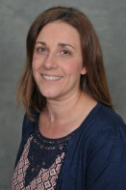
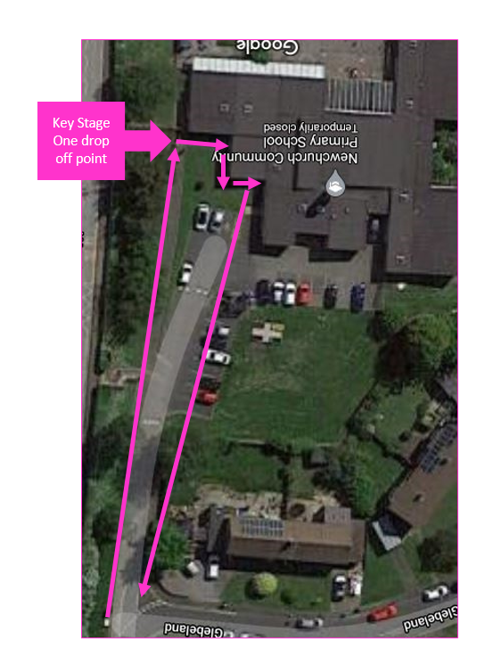
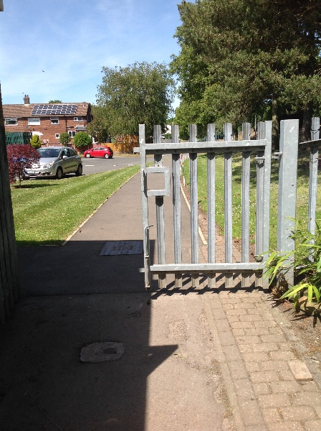
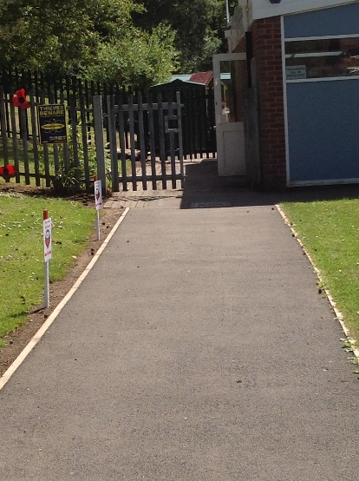
Arrival and Departure
Mrs Sizer
Miss Sullivan
Drop off point
A member of the Reception team will be stood at the gate ready to collect the children. They will then be guided round to their classroom entrance.
There is a one way system for leaving the school grounds. Parents and children will need to follow the arrows. A member of the office staff will guide you.
Collection point – your parents will wait at the markings and we will take you to them.

Slide 4
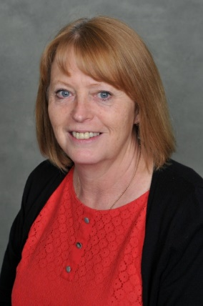
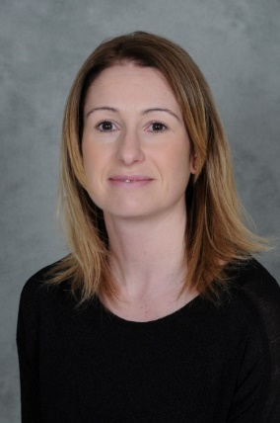
What if we need to contact the office or the classteacher?
Mrs Heath
Mrs Dowling
Although we celebrate our ‘Open door’ approach to partnership with our families, we need to reduce any risk there may be to everyone in our school community.
Therefore, the school office ‘hatch’ will not be open at all to parents. Please do not be offended if we turn you away and ask you to ring or email us. This is for everyone’s safety.
Don’t worry, Mrs Heath and Mrs Dowling will still be on hand to answer any questions or support you. Please contact the office via phone on 01925 763427 or by emailing newchurch_primary@warrington.gov.uk
If you need to speak with a member of staff, this will need to be via appointment – please do not keep them chatting at the gate as this will cause problems with other year groups. If you need to pass on a message, please contact the office and they will pass it on to the class teacher who will contact you outside of the school day.

Slide 5
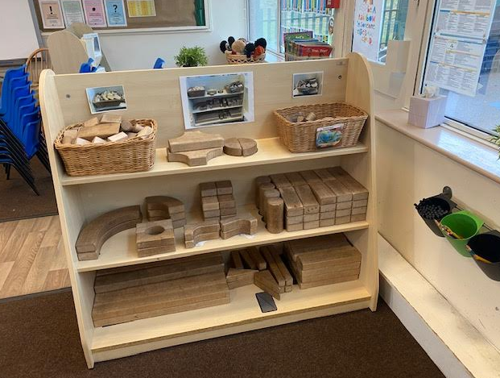
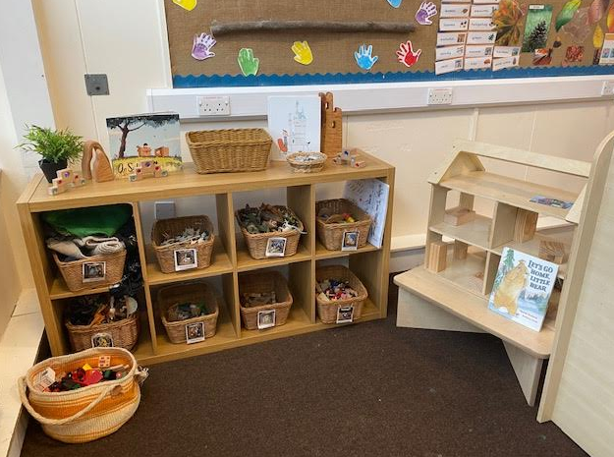
What will the learning environment look like?
The reception classroom is set up as it usually is with different areas of learning for the children to access. The children will be able to access the indoors as well as the outdoors but in groups to reduce numbers.
There will be a place to be imaginative and construct things. These are all resources that can we cleaned easily.

Slide 6
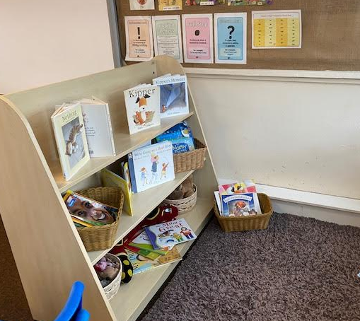
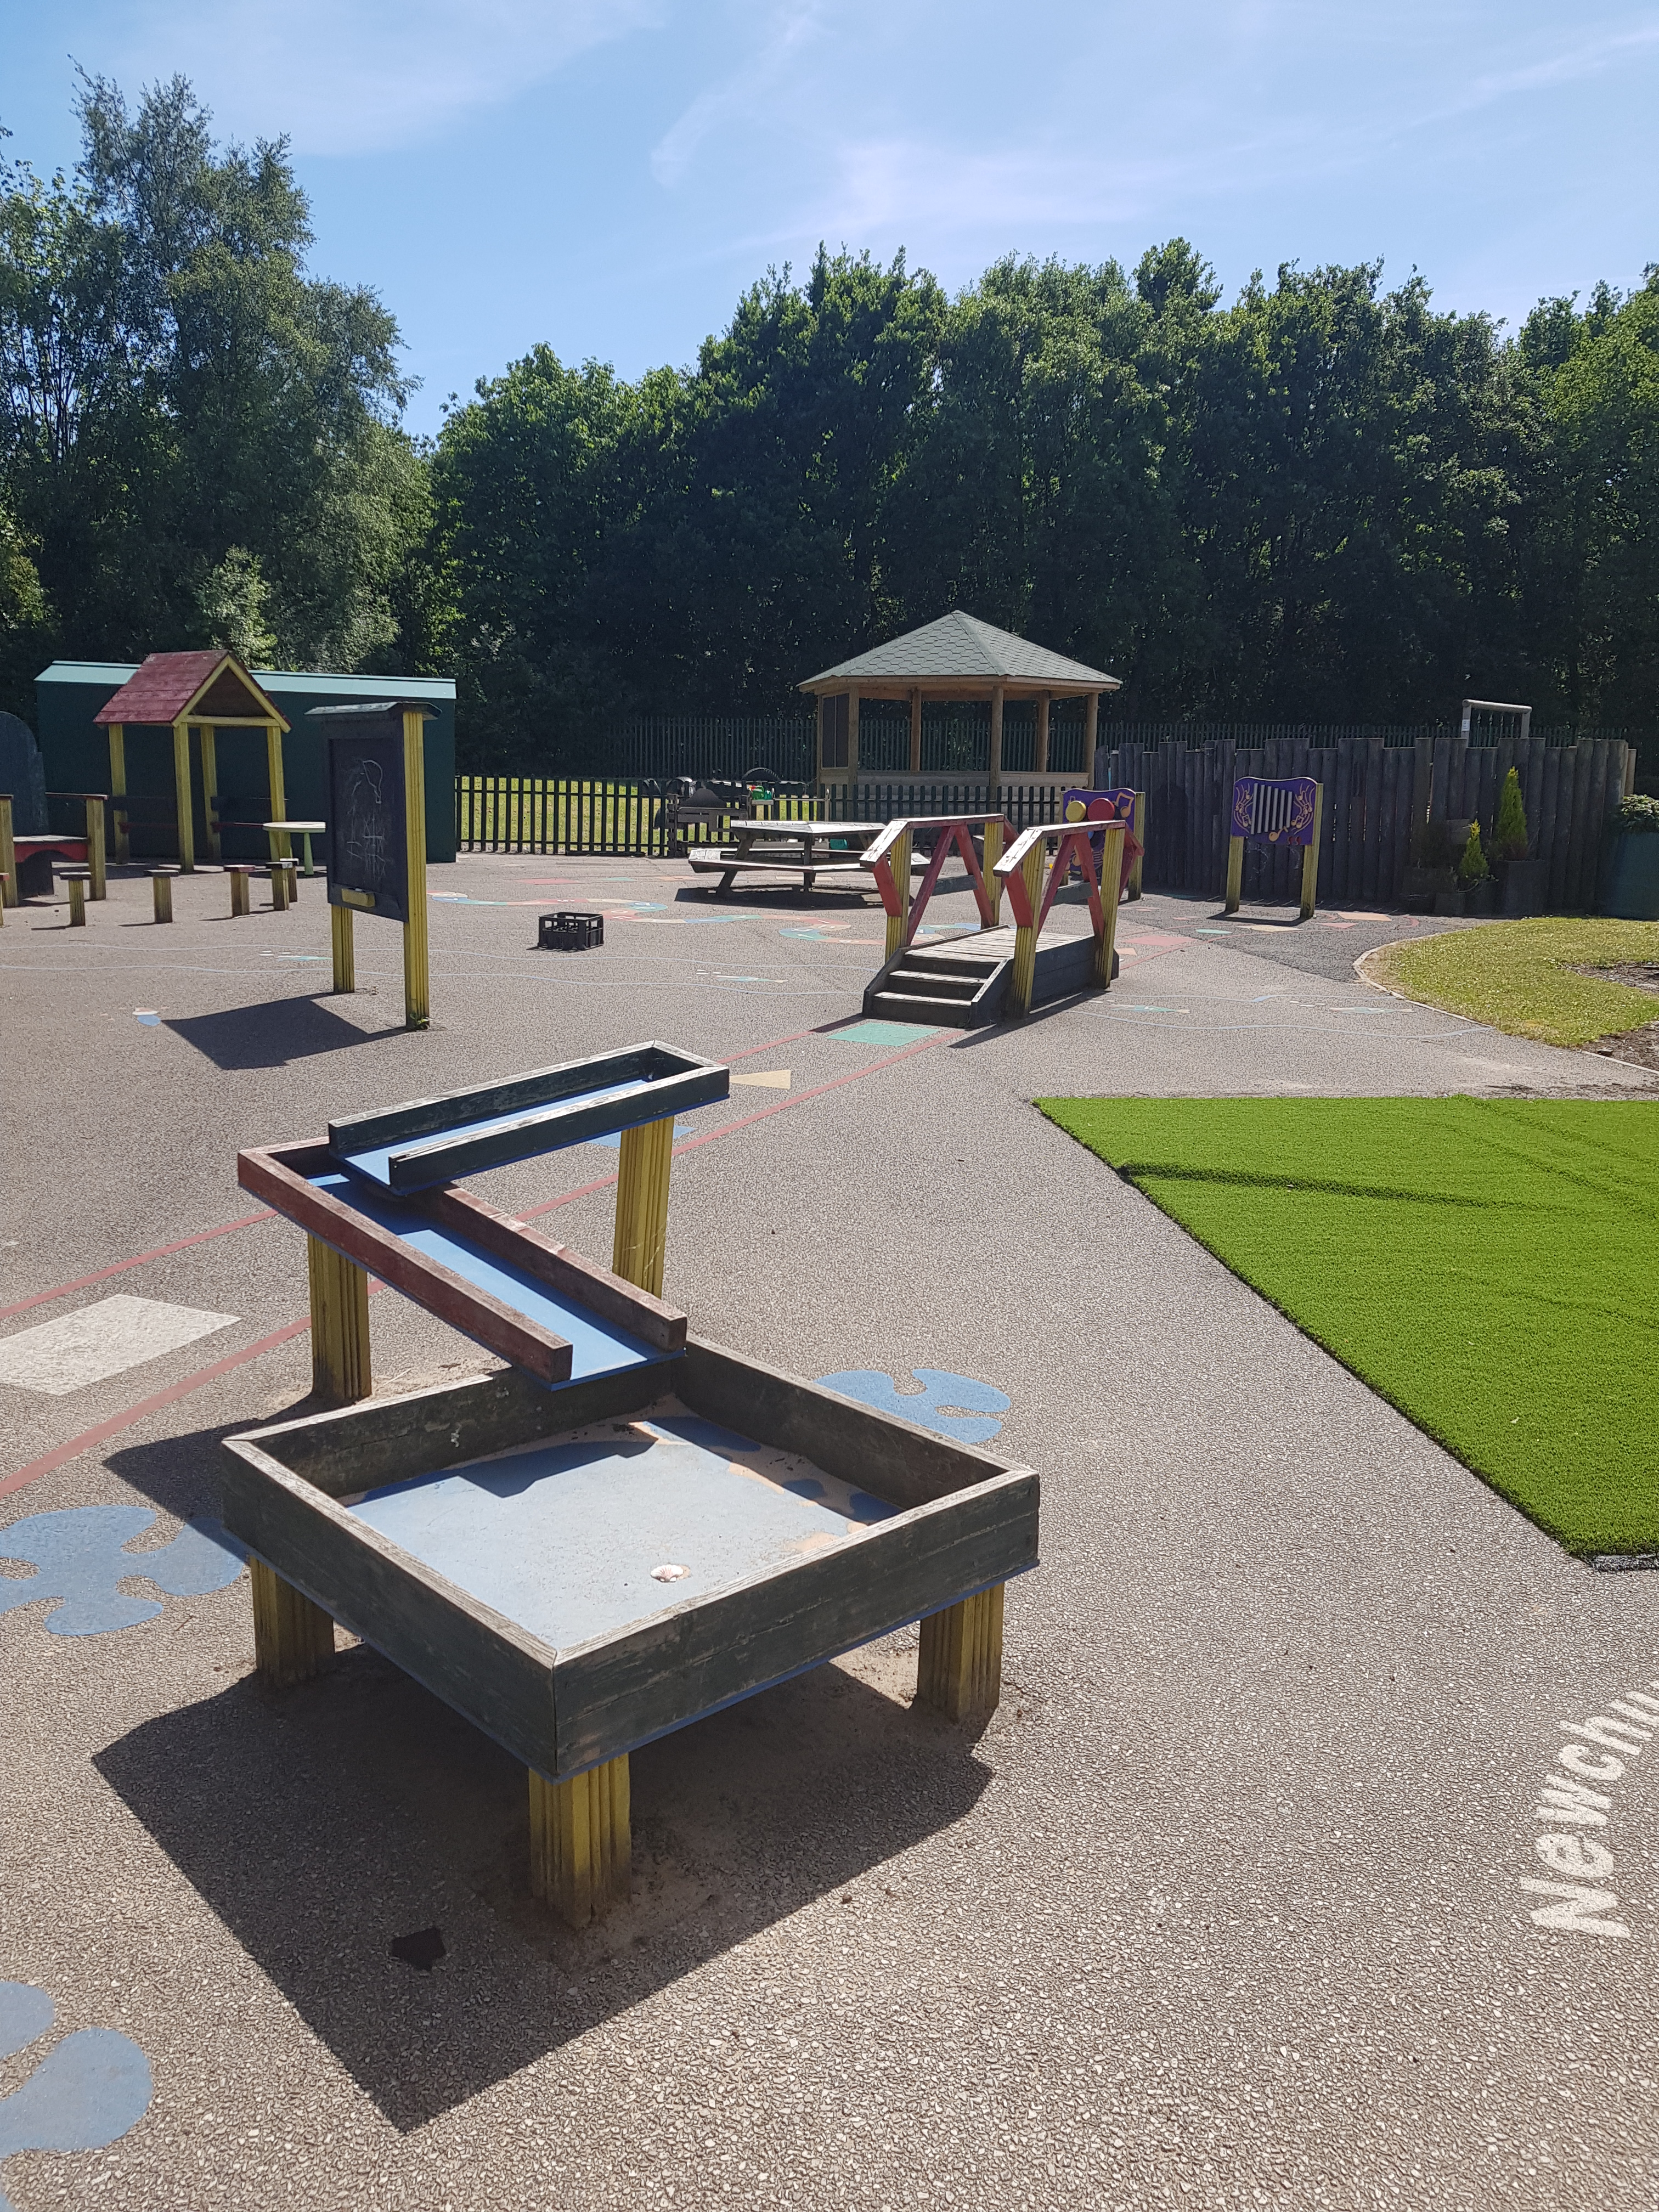
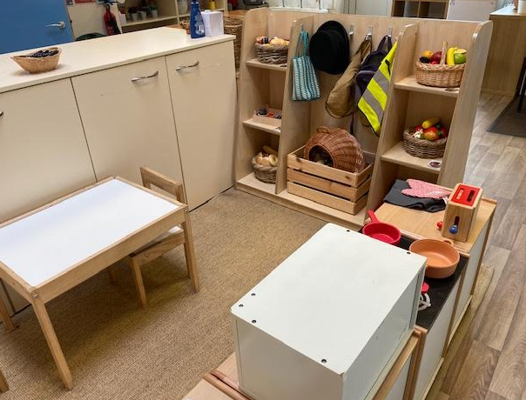
What will the learning environment look like?
There is a place to enjoy books.
You will also have your outdoor space.
There is a place to be involved in role play.

Slide 7
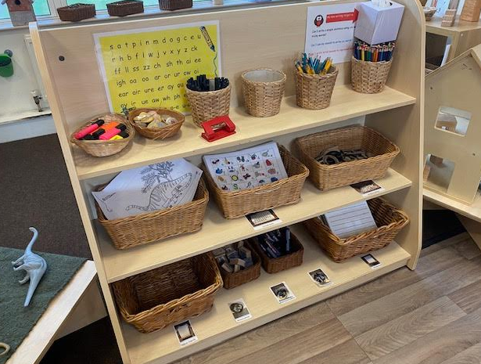
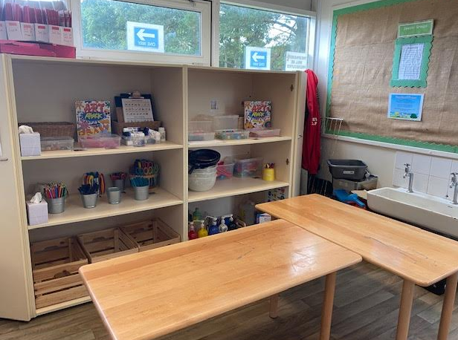
What will the learning environment look like?
A place to be creative.
A place to be an author.
Between each group of children, desks and chairs will be cleaned and resources sprayed.
This is where the children will have direct teaching from the teacher. They will be sat with one other child and all facing the front with 2m between them and their teacher. If a child needs help, the member of staff will support them but ensure social distancing and hygiene protocols are maintained.

Slide 8
Snack
All snack will be individually wrapped. Snack will be delivered to the classroom door by a member of the kitchen staff. They have been given the allocated times so they should be there at the right time. If you require snack from the kitchen, then this will need to be paid for via ParentPay. Snack from the kitchen will only be available after Easter.
Children may bring in snacks from home. These MUST be healthy. This is our challenge this year as last year children were increasingly bringing in sweets, crisps and chocolate bars. The children must leave their snacks in their book bags.

Slide 9
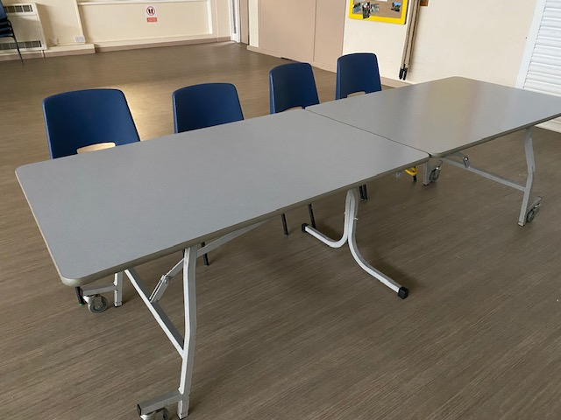
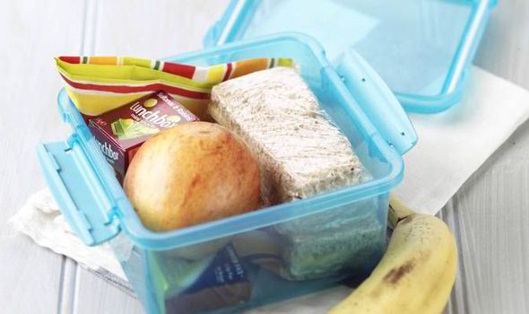
Lunchtimes and Break times
All children in Reception will eat their lunch in the school hall. The tables will be organised so that the children are all facing the same way.
Reception will have their lunch from 11:40am – 12:40am.
A timetable has been set so that only one class at a time is in the school hall eating their lunch at any one time. There is sufficient time to allow slower eaters to finish their lunch.
Children will follow the one way system to collect their lunch and ensure social distancing when lining up.
Any children having packed lunches will need to have it in a plastic container as it is easier to wash.

Slide 10
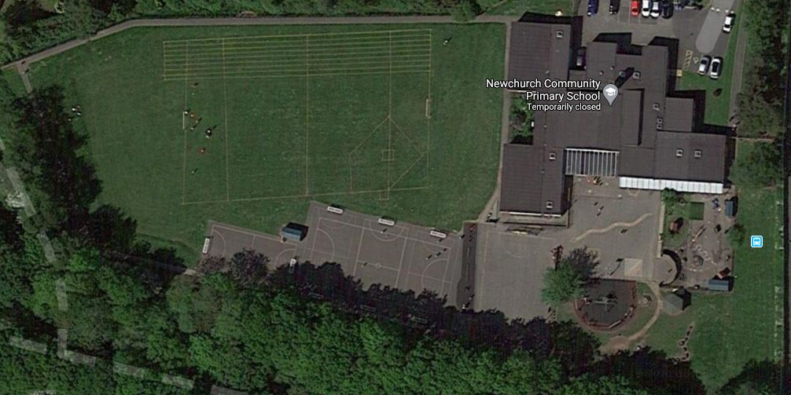
Playtimes – all staggered times
Each class will have their own set time for outdoor learning, lunchtimes or play time. A timetable will be provided to support this. The arrows show the movement to the zone.
Year 6
Year 5
Year 4
Year 3
Year 1
Reception
Year 2
Each class will be provided with outdoor play equipment which MUST NOT be shared with any other class.

Slide 11
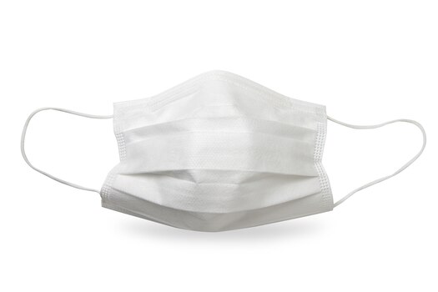
What the children need
The children will still be able to bring their reading bags in. No other bags are needed. Children will be given reading books. All children’s books will be changed on FRIDAYS.
PE for Year 1 will be on Fridays. The children will need to come into school in their PE kit:
Black shorts/joggers/leggings
Plain white round neck t-shirt
Black hoodie
Trainers
The children can bring in a labelled water bottle that will be kept in a designated place at all times. If they need to fill their water bottle, the children must unscrew it to allow the staff to refill it with fresh water. If they need help, we will help but we will wash our hands before and after. Perhaps you could practice this. The bottles will go home with the children at the end of the day for cleaning.
No water fountains will be used: they will be taped off.
The guidance states that children are not required to wear a mask.

Slide 12
Curriculum
In the first few weeks of the return leading up to Easter, the focus will be on settling the children back in by following our Pastoral Curriculum. This will help the children to re-engage with their learning and also focus on the Personal, Social, Health and Emotional areas the children will need in order to continue effectively with their learning. The children have clearly missed their friends and time will be given to helping them re-establish relationships and get back into the routine of a full day in school.

Slide 13
What do I do if I want to hug my friend?
The children will want to give their friends a hug and play close to them but they have to try not to. There are lots of different ways they can still be with their friends. Click on the picture of ‘The Hug’ to watch a short video of ways your child can show they care.

Slide 14
How can I keep myself and others safe?
Hi. I am Red Robin Remembers. If you see me, I am a reminder to keep your distance.
We have put signs up around school to help the children to remember to keep safe, like keeping themselves apart. We want them to try to imagine there is a cow between them and the other person when not in lesson times.
School will try to keep the children as safe as possible. They can help by listening very carefully to the instructions their teacher gives them.
You can also make sure that you and your family keep to the rules of social distancing outside of school time and engage with the NHS Track and Trace initiative.

Slide 15
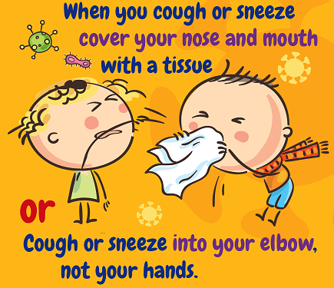
Coughs and sneezes
We have put lots of boxes of tissues around the classroom so the children have a tissue nearby at all times.
The children will need to put them in the bin after they have used them and the bin will be emptied twice a day.
You will need to wash your hands.
REMEMBER…
If someone coughs or sneezes, it doesn’t mean you are going to catch coronavirus.

Slide 16
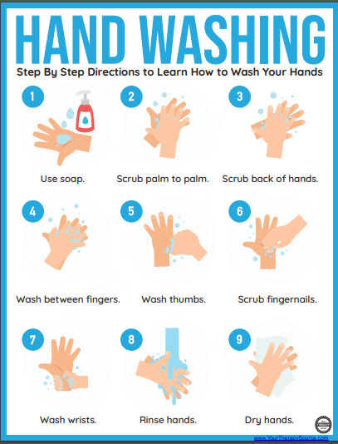
How will they make sure they don’t catch germs?
The children will need to wash their hands:
When they arrive at school and before they leave
Before and after eating
After going to the toilet
After sneezing or coughing into their hands
When they have used a tissue
At regular timetabled intervals throughout the day
The adults in each class will help them to remember to this so don’t worry.

Slide 17
Toileting
The children can go the toilet when they need to. We will remind them at different times of the day.
The guidance states that the children within each ‘bubble’ (in our case each class) can use the same toilets.
The toilets will be cleaned at intervals throughout the day.

Slide 18
Moving around school
The children will spending most of their time in the classroom or outside. Assemblies will be delivered virtually.
They will be with an adult all the time so they will help the children to know which way to go and how to keep apart from one another.
They will see signs around the outside of schools like this which show the children and parents which way to go.
Children will not be allowed to wander around schools on messages etc.

Slide 19
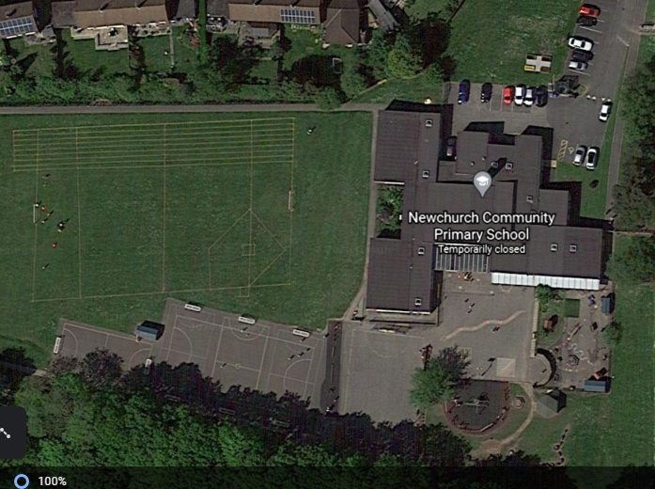
Fire evacuation
If the fire alarm goes off, the children will need to follow their adult’s instructions to the place each class has been designated. In a practice situation, then we will aim for social distancing, but if a real fire occurs, we will aim to get the children out as quickly as possible. We will need to practice this.
Reception

Slide 20
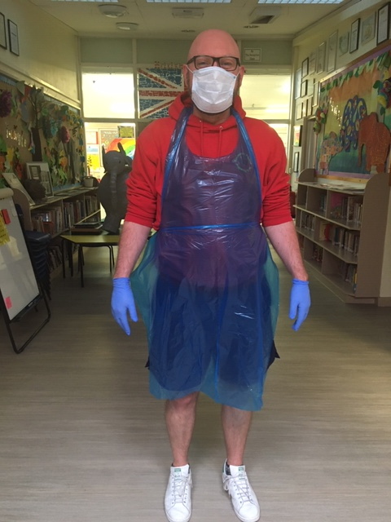
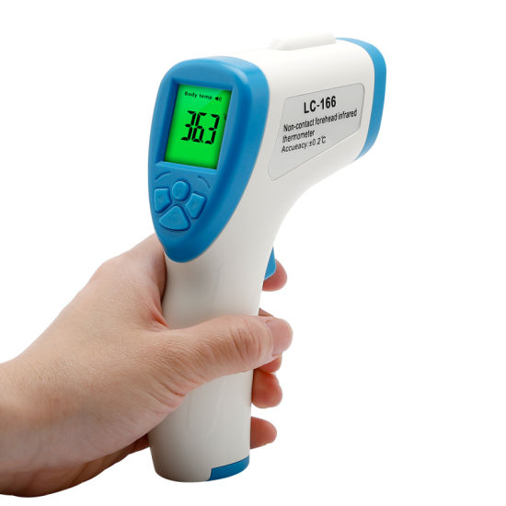
Feeling ill and first aid
If a child is ill, a first aider will come to collect them and take them to the designated space for first aid.
If a child has cut themselves or grazed their knee, they will be shown how to try and clean it themselves but don’t worry if they can’t, we will help.
The adult may need to wear some things to keep everyone to keep safe, but don’t worry. Here is a picture of what Mr Duckett looks like in his things.
If they have a temperature, we will use one of these to help find out how hot they are.
We will call the child’s parents to come and collect them. They will be asked to go and get a test as soon as possible and inform the school of the outcome.

Slide 21
What if someone is tested positive?
If a child or member of staff is tested positive, then the school will contact the Local Authority and Public Health to find out the next steps and be guided by them. They may decide to ask the children and teacher in the class to self-isolate for 10 days.
The children’s learning will then become online and parents will need to home school the children. There would be an expectation of 100% engagement from all children to avoid any further gaps in learning developing.
The best way to avoid this is to maintain effective social distancing and enhanced hygiene at all times inside and outside of school.

Slide 22
Get prepared
Steps to Success
Step 1
Start to re-establish a bedtime routine to regulate sleep patterns and support well-being
Step 2
Try to read every night or practise times tables
Step 3
Get in the habit of getting all uniforms and bags ready before bedtime to make the morning easier.

